Slide 1

STARDUST
ISO8583 Blockchain Integration Deep Dive
Adit Patel (adit.patel@stardustfunds.com)

Slide 2



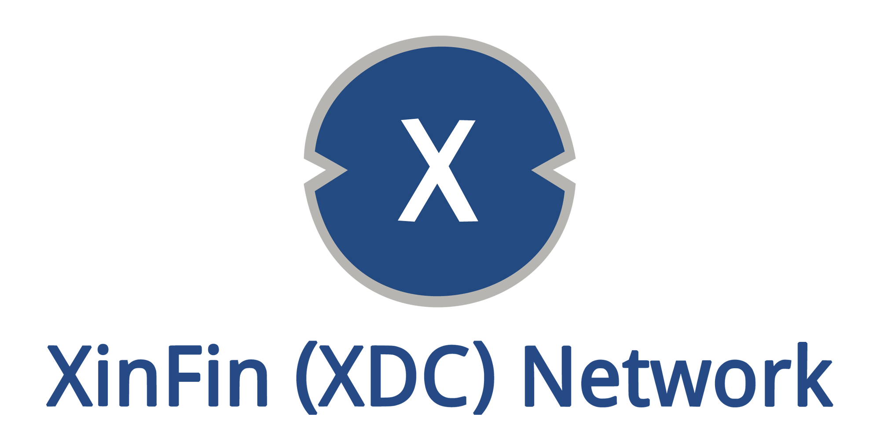
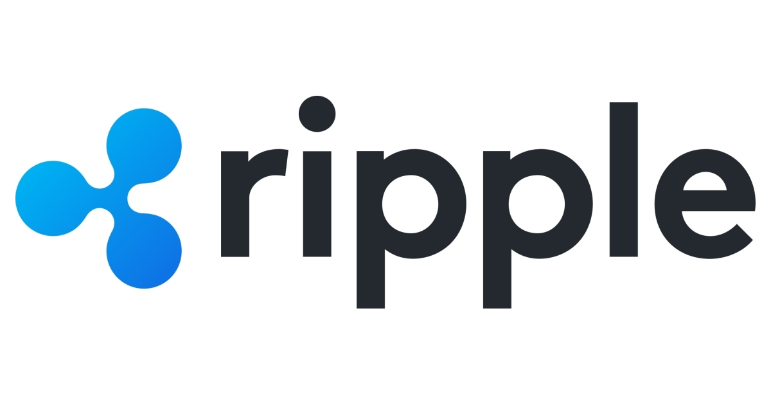

Seamless integration with traditional banking infrastructure, especially payment card transactions, would give distributed ledger users unparalleled versatility and control over their assets.
Several networks have attempted to adopt traditional banking data standards specifically ISO20022 as part of their strategies.
However, these networks all share a few key characteristics.
Centralized:
While the amount of centralization varies by project, all of these projects fundamentally differ from the fully decentralized models of traditional blockchains. Centralization ranges from networks relying on a few permissioned nodes to network that rely on a single, centrally coordinating node, like IOTA.
Permissioned:
Even for networks that operate multiple nodes, individual user cannot simply host these nodes without first receiving permission from the parent organization.
Large Corporate/Government Backing:
Nearly all of these projects have a large incumbent backer. Whether that is networks like Stellar, which is supported by IBM and Deloitte, or Algorand which appears to have close ties to the Chinese Communist Party and had direct integration with China's state-backed Blockchain-based Service Network (BSN).
Notes:
https://www.cryptopolitan.com/iso-20022-compliant-crypto-list/
https://www.algorand.foundation/news/bsn-integration-algorand
https://www.pwc.in/assets/pdfs/consulting/financial-services/fintech/point-of-view/pov-downloads/decoding-payments-message-standards.pdf

Slide 3
This report will focus specifically on integrating payment card transactions and their associated data messaging standard, ISO8583 and the closely related Australian Standard AS2805*.
ISO8583 messages are used to streamline and standardize information during a payment card transaction.
JSON, XML or
Other Custom API
ISO8583 or
AS2805
ISO8583 or
AS2805
Merchant
Amazon.com
Payment Processer
Stripe
Payment Network
VISA/MasterCard
Issuing Bank
Citibank
Merchant to Payment Processor
Any language can be used to accept transactions on the merchant site and communicate them to the payment processors. Today Stripe has client libraries in Ruby, Python, Java, Node, and many others. In addition, they also support JSON API calls over the internet or even mobile applications. Data standards at this rate are left up to the engineering team at the merchant.
Payment Processor To Network
As the user ‘swipes’ their card or enters transaction details, the payment processer converts the transaction request at the point of sale to an ISO8583 formatted message, or AS2805 format in Australia. We’ll detail what this looks like on the next slide.
Intra-Financial Markets
This ISO8583 is then sent through secure connections directly to the issuing bank who runs it through fraud models and either approves the transaction or declines it. This approval/decline message itself is return coded in ISO8583.
*AS2805 from a messaging perspective is nearly identical to ISO8583 and should be thought of as interchangeable for the purposes of this architecture.
Notes:
https://www.omise.co/the-pioneer-of-financial-messaging-iso8583-in-a-nutshell

Slide 4
The format of an ISO8583 message is relatively straightforward, and consist of a few key parts.
The MTI identifies the key information, the Bitmap specifies the metadata, and the Data Elements encode the actual data.
Example Message
0 | 1 | 0 | 0 | 4 | 2 | 1 | 0 | 0 | 0 | 1 | 1 | 0 | 2 | C | 0 | 4 | 8 | 0 | 4 | A | C | D | 1 | 3 | 4 | 1 | 4 | 5 | 1 | 4 | …
Message Type Identifier (MTI)
This encodes who is sending the message, why, what they would like to do, and what standard this message conforms to.
Primary Bitmap
This is a 64 bit map indicating which fields have been provided in this message. These first 64 bits here have been encoded into a 16 character long hexadecimal string. These first bitmap is called the primary bitmap and is mandatory. Up to a total of 3 bitmaps can be contained in a single message though more than 2 is rare.
Data Elements
This is the actual payload associated with the metadata listed in the bitmap. It conforms to fields of fixed widths so the data can be verified for accuracy and that it was transmitted error free. This data can be decoded to match all of the data fields provided by the primary bit map.
Notes:
https://www.omise.co/the-pioneer-of-financial-messaging-iso8583-in-a-nutshell

Slide 5
The MTI arguably specifies the most important information, and makes it easy to identify the key classification of a transaction at a glance.
Each digit of the MTI indicates a vital piece of information about the message, from type to origination.
Example Message
0 | 1 | 0 | 0 | …
ISO8583:1987 Coded Authorization Request by Acquirer
First Digit - Standard
This is the standard of ISO8583 this message conforms to. There are 3 standards, 1987, 1993, 2003.
Second Digit - Class
At a high level this indicates what type of message it is, from approvals to reversals.
Third Digit – Request Type
Indicates if the message is a response or needs a response or acknowledgement.
Fourth Digit - Source
Indicates who originated the message.
0xxx – ISO8583:1987 (most common)
1xxx – ISO8583:1993
2xxx – ISO8583:2003 (rare)
x0xx – Authorization
x1xx – Authorization
x2xx – Financial
x3xx – File Action
x4xx – Reversal
x5xx – Reconciliation
x6xx – Administrative
x7xx – Fee Collection
x8xx – Network Management
xx0x – Request
xx1x – Request Response
xx2x – Advice
xx3x – Advice Response
xx4x – Notification
xx5x – Notification Acknowledgement
xx6x – Instruction (2003 only)
xx7x – Instruction Acknowledgement
xx8x – Positive Acknowledgement
xx8x – Negative Acknowledgement
xxx0 – Acquirer
xxx1 – Acquirer Repeat
xxx2 – Issuer
xxx3 – Issuer Repeat
xxx4 – Other
Notes:
https://sites.google.com/site/paymentsystemsblog/iso8583-financial-transaction-message-format

Slide 6
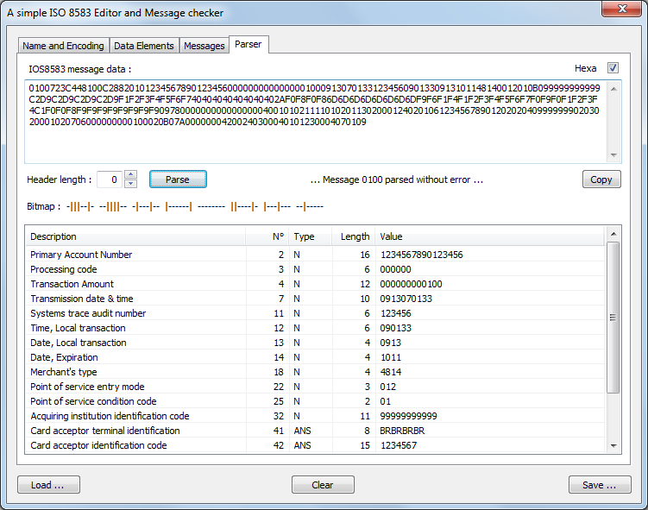
The primary bitmap and data elements are standardized, to allow anyone to decode the message contents easily as well as validate the message has been received in its entirety.
Standardizing this data allows anyone on the network to identify the type of transaction and easily decode the metadata fields and retrieve the data.
From this ISO8583 message, a bank can quickly identify the important information.
Identity:
The identification codes and primary account number allow a bank to quickly identify which cardholder swiped their card and which merchant account needs to be paid.
Transaction Details:
Under “Transaction Amount” we can see that this transaction was for $1 as it is denominated in pennies, the quanta unit of the specified currency. Fields #49 and #52 would provide us the ISO4217 currency code.
Notes:
https://medium.com/@mohammad2603/tools-for-a-iso-8583-developer-7709bcae9e5a

Slide 7
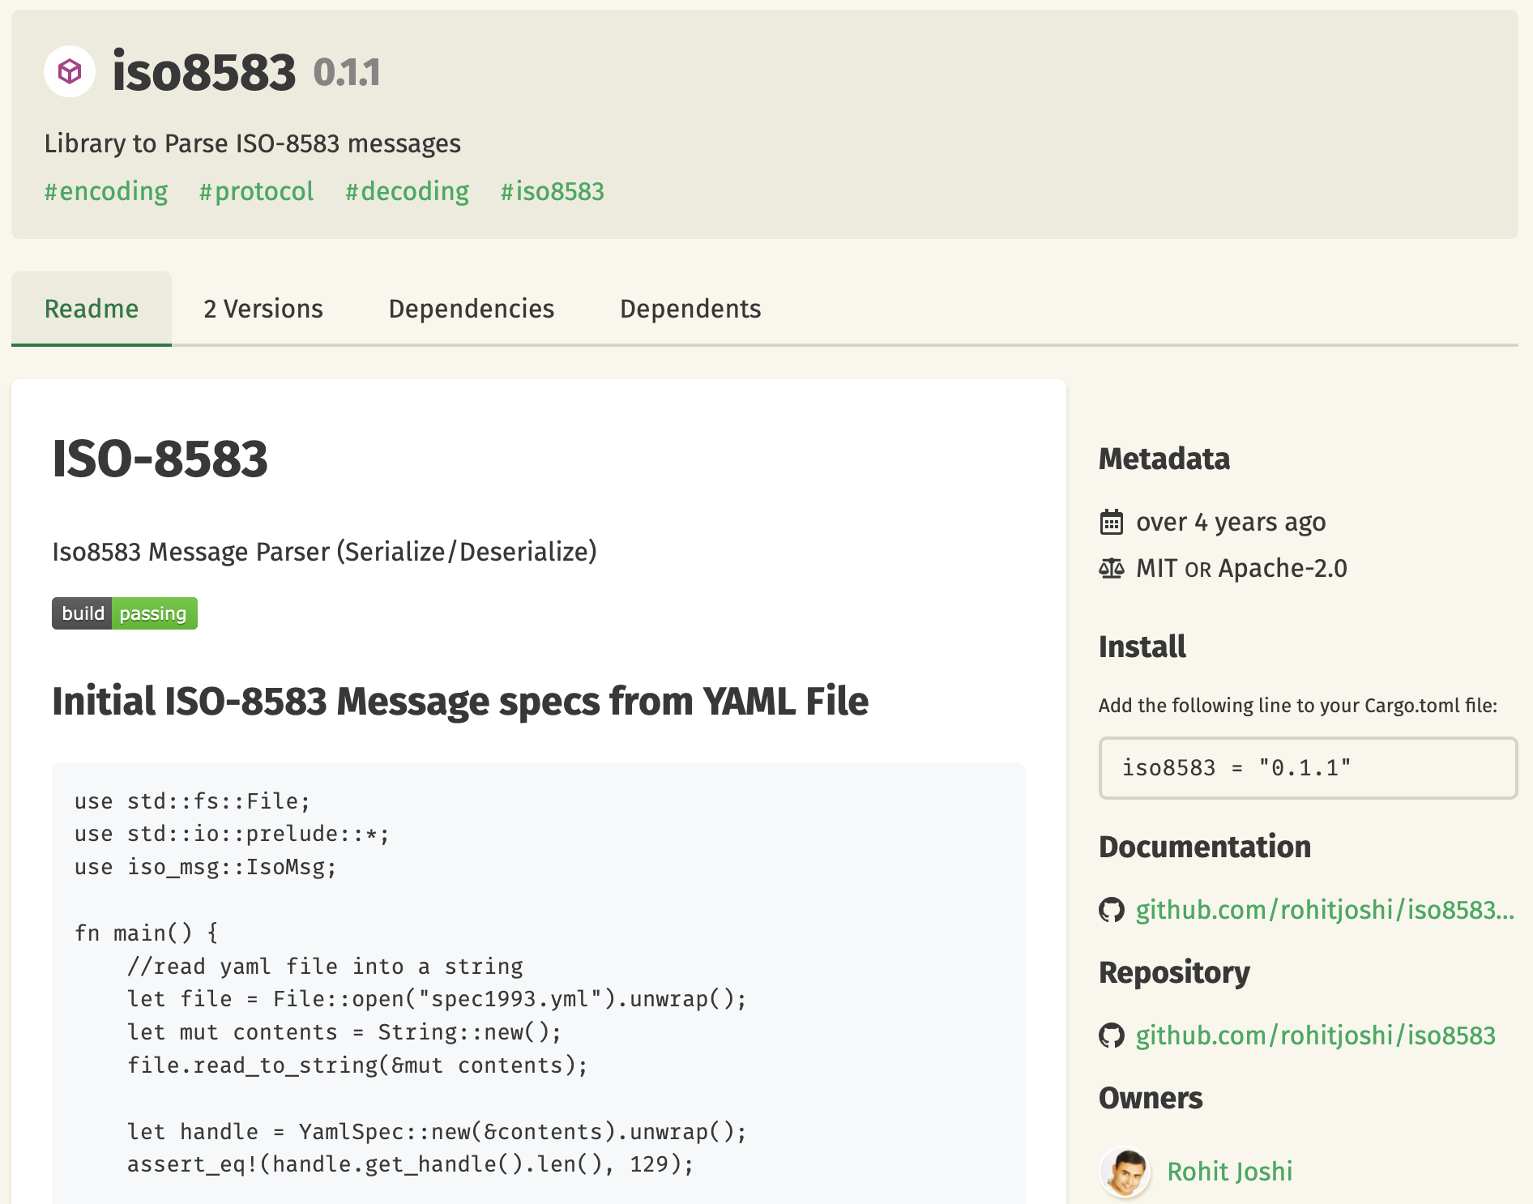
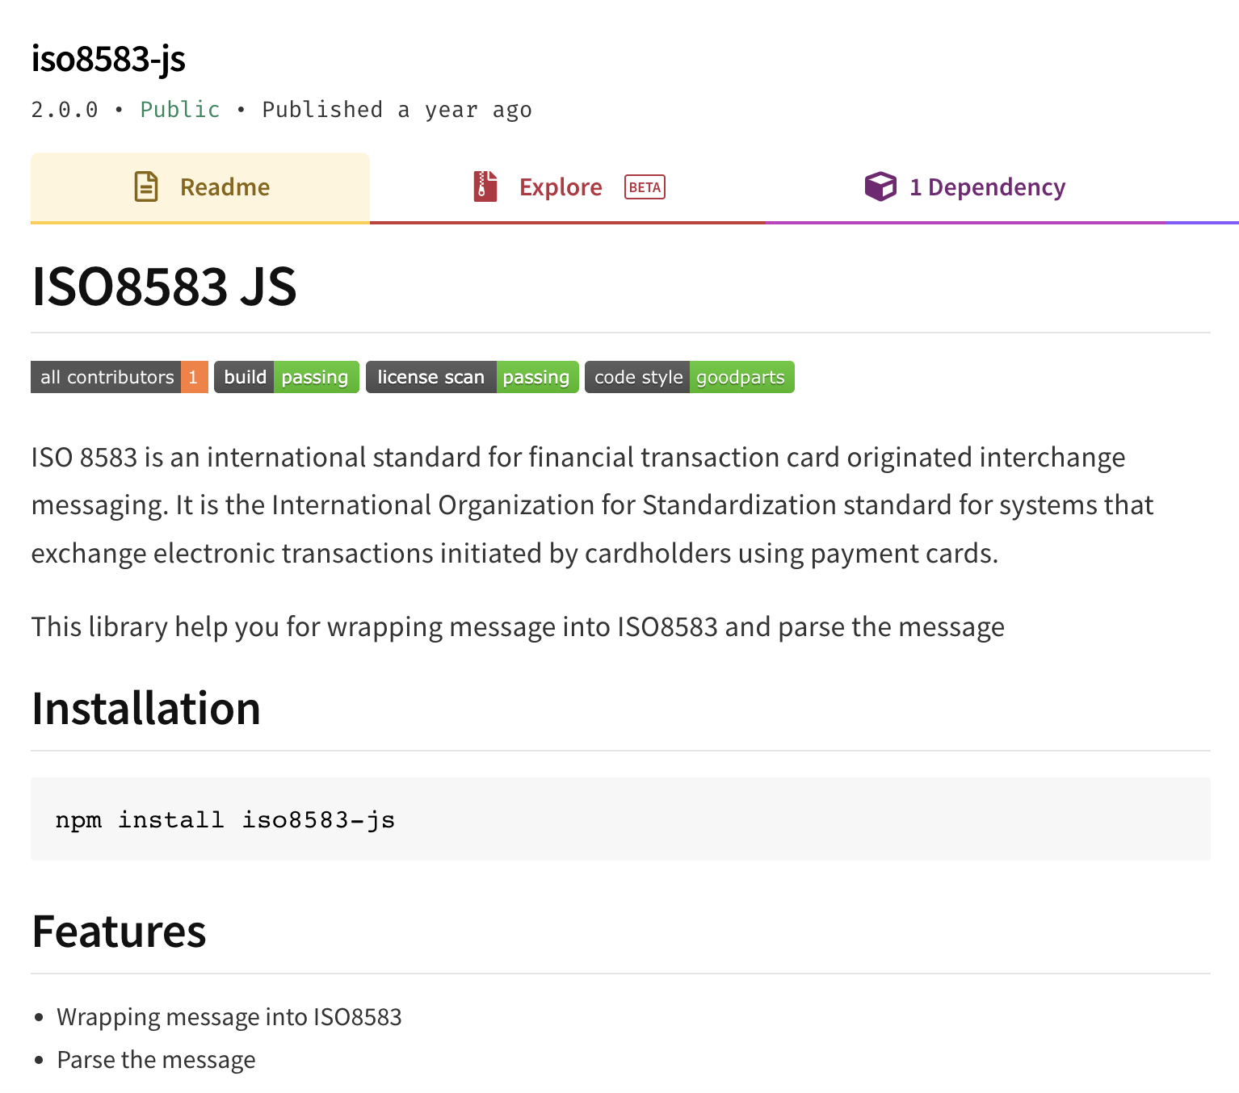
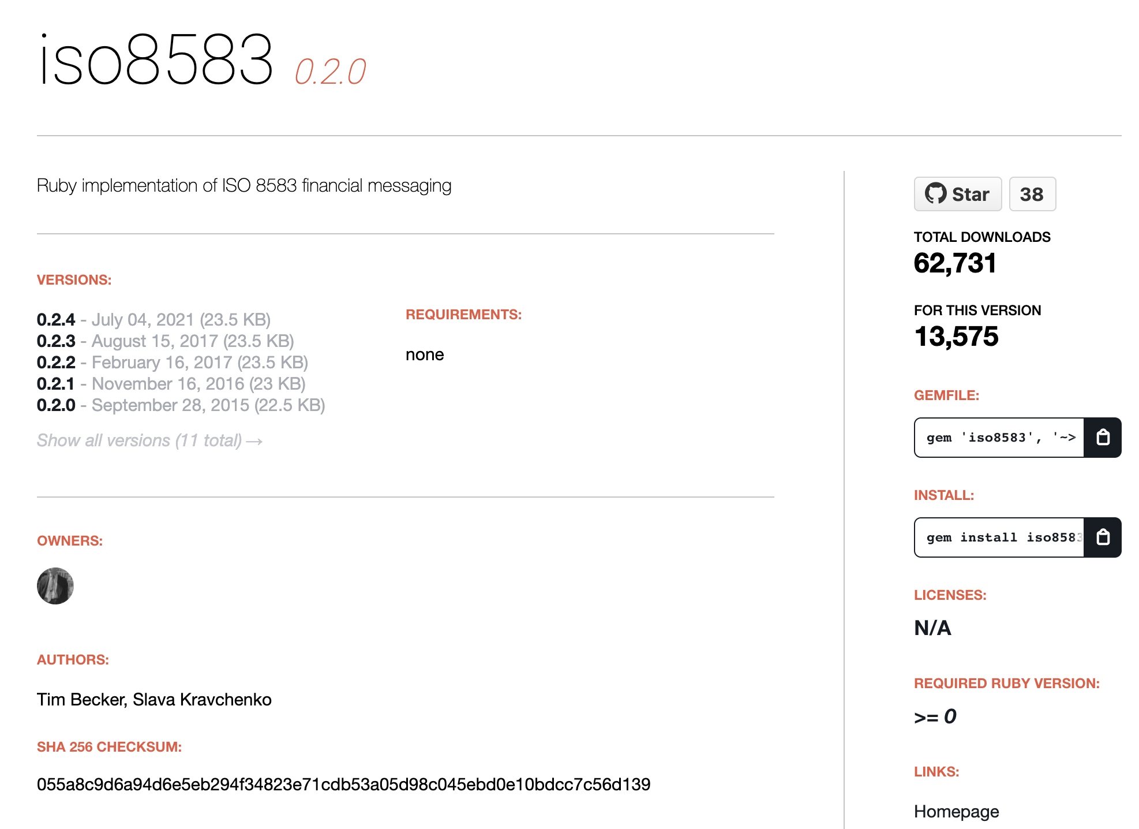
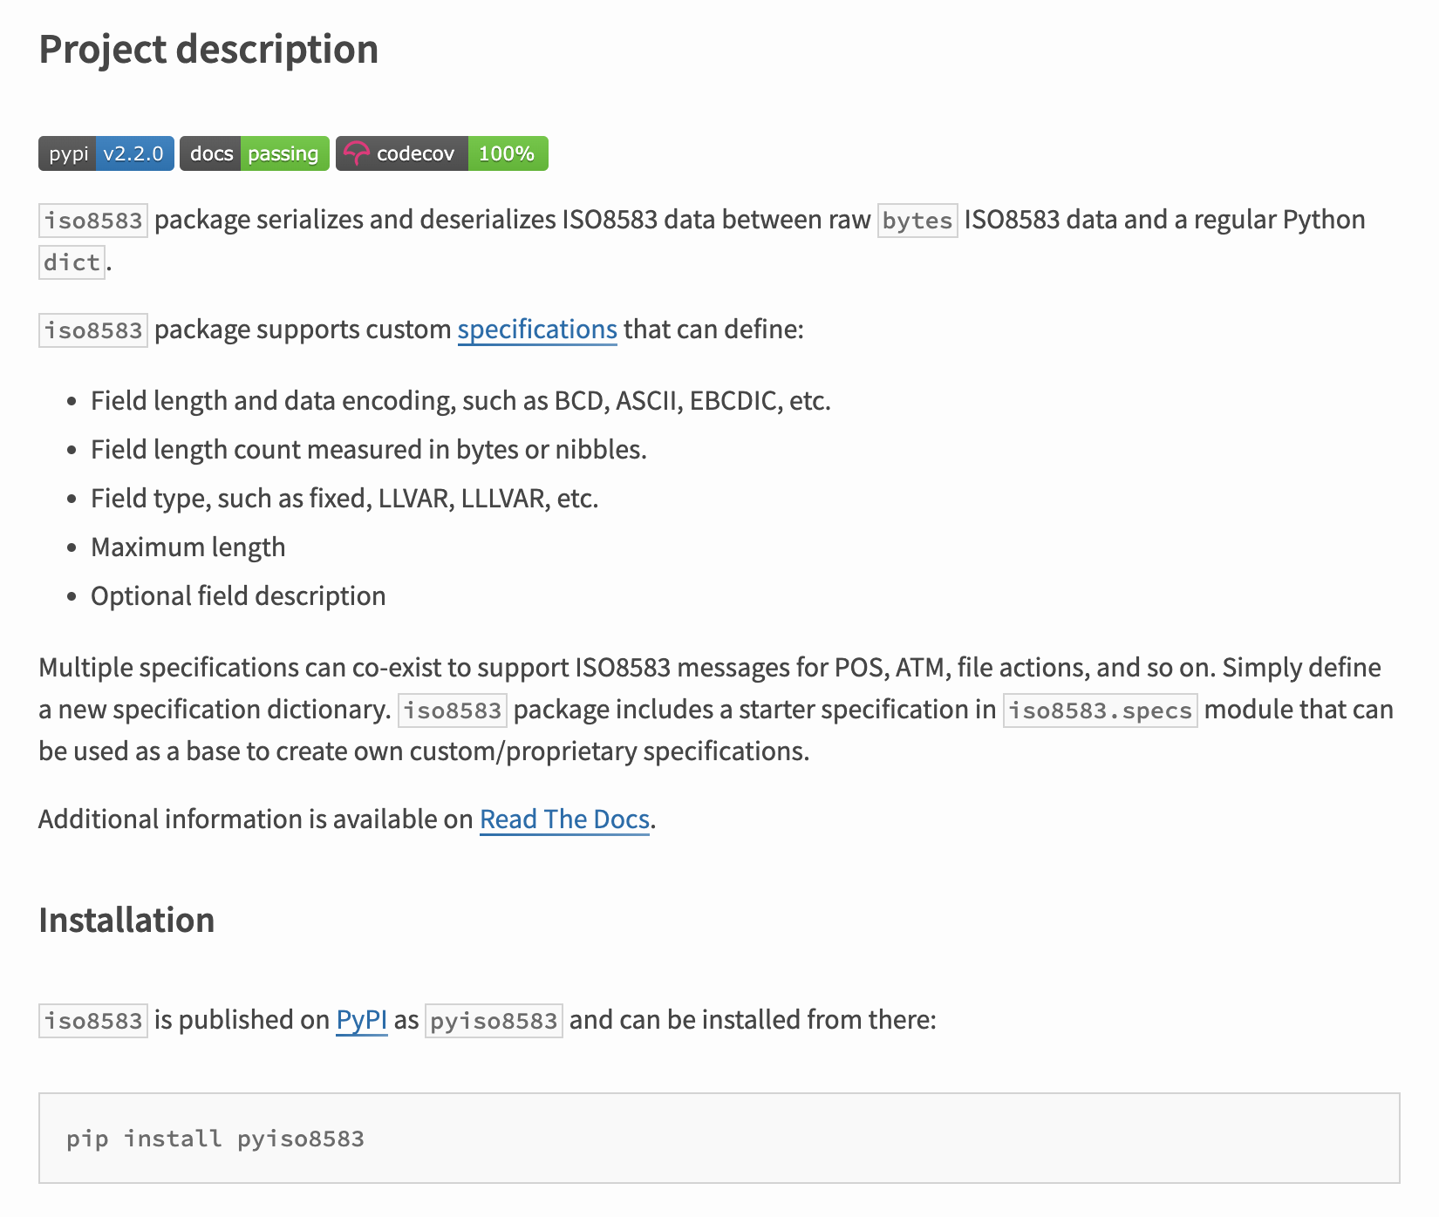
Several packages exist to help streamline the encoding and decoding of IS8583 messages. Seemingly making it easy to integrate and transmit ISO8583 transactions with Substrate.
These tools are open-source and production ready. They are capable of seamlessly ingesting ISO8583 data streams and decoding them into native, accessible objects in nearly any language including Rust.
Rust
Ruby
Javascript
Python
Notes:
https://crates.io/crates/iso8583
https://rubygems.org/gems/iso8583/versions/0.2.0
https://www.npmjs.com/package/iso8583-js
https://pypi.org/project/pyiso8583/

Slide 8
Despite the ubiquity of libraries, market dominance of payment cards, and future-proofed entrenched position; no blockchain network has attempted to support ISO8583 transactions.
Several networks have attempted to adopt the ISO20022 as part of their strategies.
But despite its ubiquity and utility, none have attempted to adapt ISO8583.
Market Share of Payment Card Industry
ISO8583
Other
Universal Ubiquity
ISO8583 is the dominant messaging format for retail and payment cards, one of the largest segments of the financial industry and will be for the foreseeable future. Despite this and the large number of blockchains attempting to integrate 20022, no blockchain has attempted to integrate ISO8583.
Entrenched Standard
Even though ISO20022 can support payment cards, it is very unlikely the industry will adopt the new standard. The rich metadata of ISO20022 has no relevance for payment cards, and the current business case indicates the net effect of migration would result in a $1B loss to the industry.*
*https://www.apb.it/wp-content/uploads/2016/09/iso-8583-vs-20022-cards-mandatory-migration-required-yet-anzellotti.pdf
Notes:
https://www.cryptopolitan.com/iso-20022-compliant-crypto-list/
https://www.pwc.in/assets/pdfs/consulting/financial-services/fintech/point-of-view/pov-downloads/decoding-payments-message-standards.pdf
https://www.apb.it/wp-content/uploads/2016/09/iso-8583-vs-20022-cards-mandatory-migration-required-yet-anzellotti.pdf

Slide 9


This is likely because data standards like ISO8583 were not designed for blockchain applications and integrating them poses significant challenges.
Information Security
Traditional financial transactions simply require a credit card number to execute. This means anyone who accesses an ISO8583 message has all the information they need to execute fraudulent transactions.
Authority
Nodes in a blockchain are peers with no node having authority over the others. Payment card systems have centralized players, some of whom have unilateral control over key network decisions or disputes.
Reversals
Blockchain technology relies on finality of transactions as a key component of its consensus mechanism. Payment cards transactions meanwhile are legally required to be reversable in the case of fraud.

Slide 10
As mentioned earlier, anyone on the network can unpack ISO8583 messages, which means they have complete access to the details held within.
This includes all of the sensitive financial information you would need to issue and authorize false payments.
Primary Account Numbers (PANs), more readily recognized as a credit card number, are a required field for most messages on the network.
Anyone who has access to this message would be easily be able to perform fraudulent purchases with this information
Notes:
https://medium.com/@mohammad2603/tools-for-a-iso-8583-developer-7709bcae9e5a

Slide 11
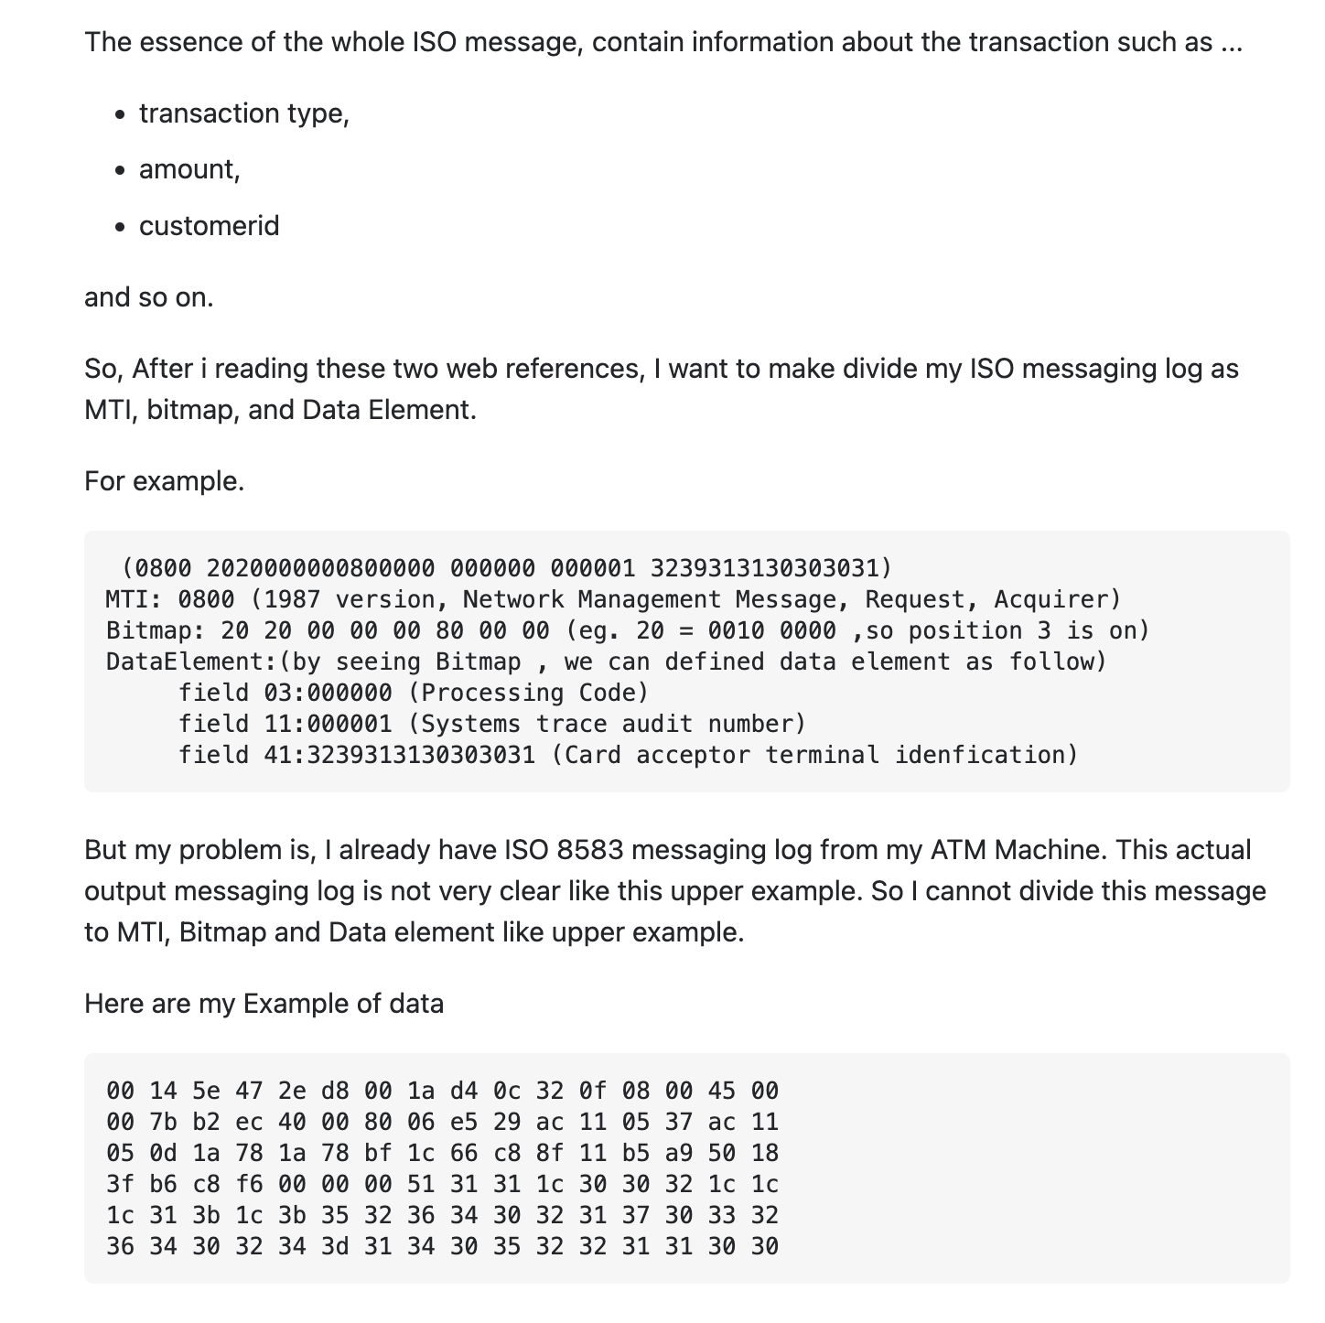
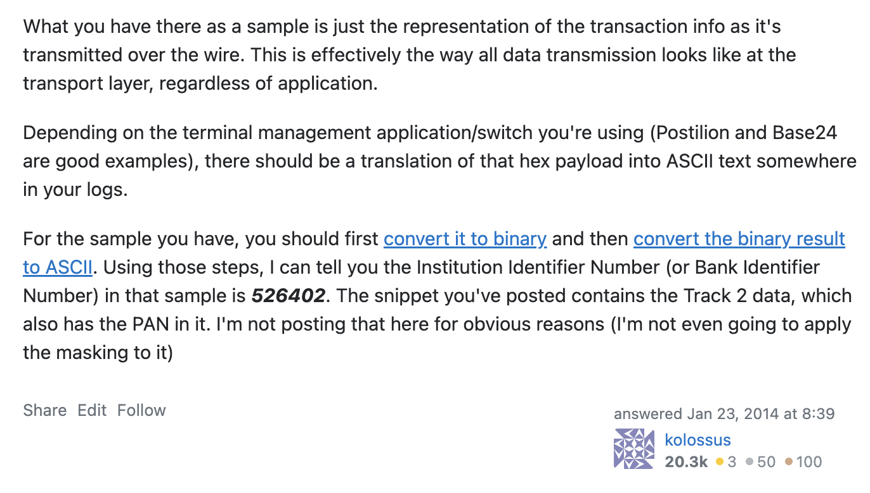
All ISO8583 messages are extremely sensitive and it’s extremely important to limit access to them. Banks avoid this through careful control of network access privileges.
Even innocent Stackoverflow questions can easily revel sensitive banking information inadvertently.
That bitmap data has revealed their credit card number, expiry date and other information.
Unpacked payload data this user is referencing:
Not only can we extract the card number, the card number itself tells us a large amount of information itself. For example, we also know that this transaction is using a Mastercard Debit Card and is referencing an account at Banque Du Caire in Egypt. Track 1 would have revealed his full name.
Here a user is asking for help processing the bitmap output of their ATM Machine.
Notes:
https://stackoverflow.com/questions/21282257/iso8583-message-decoding

Slide 12
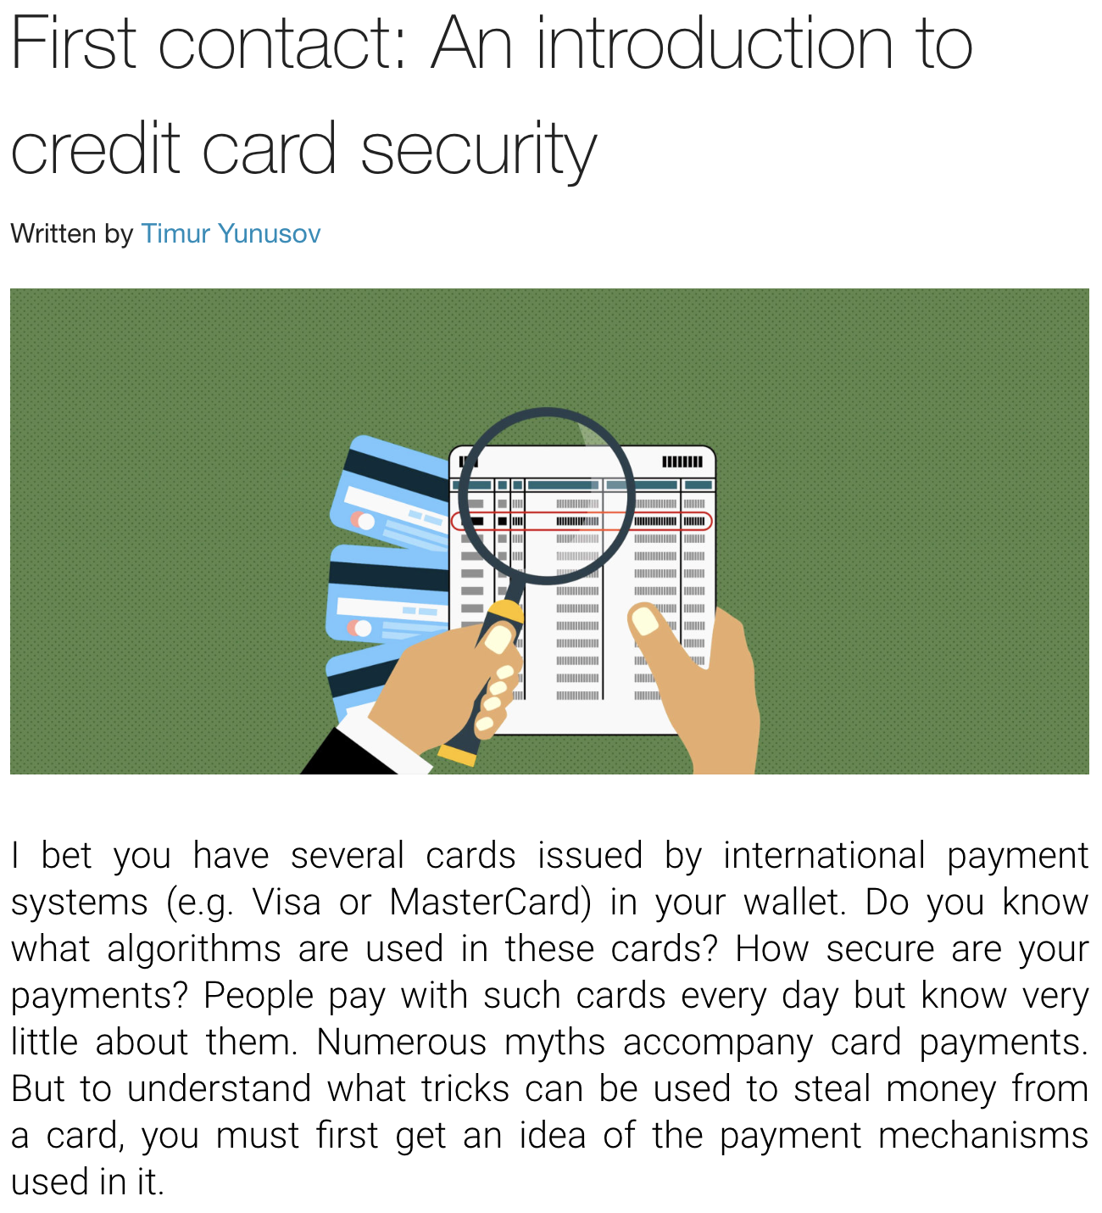
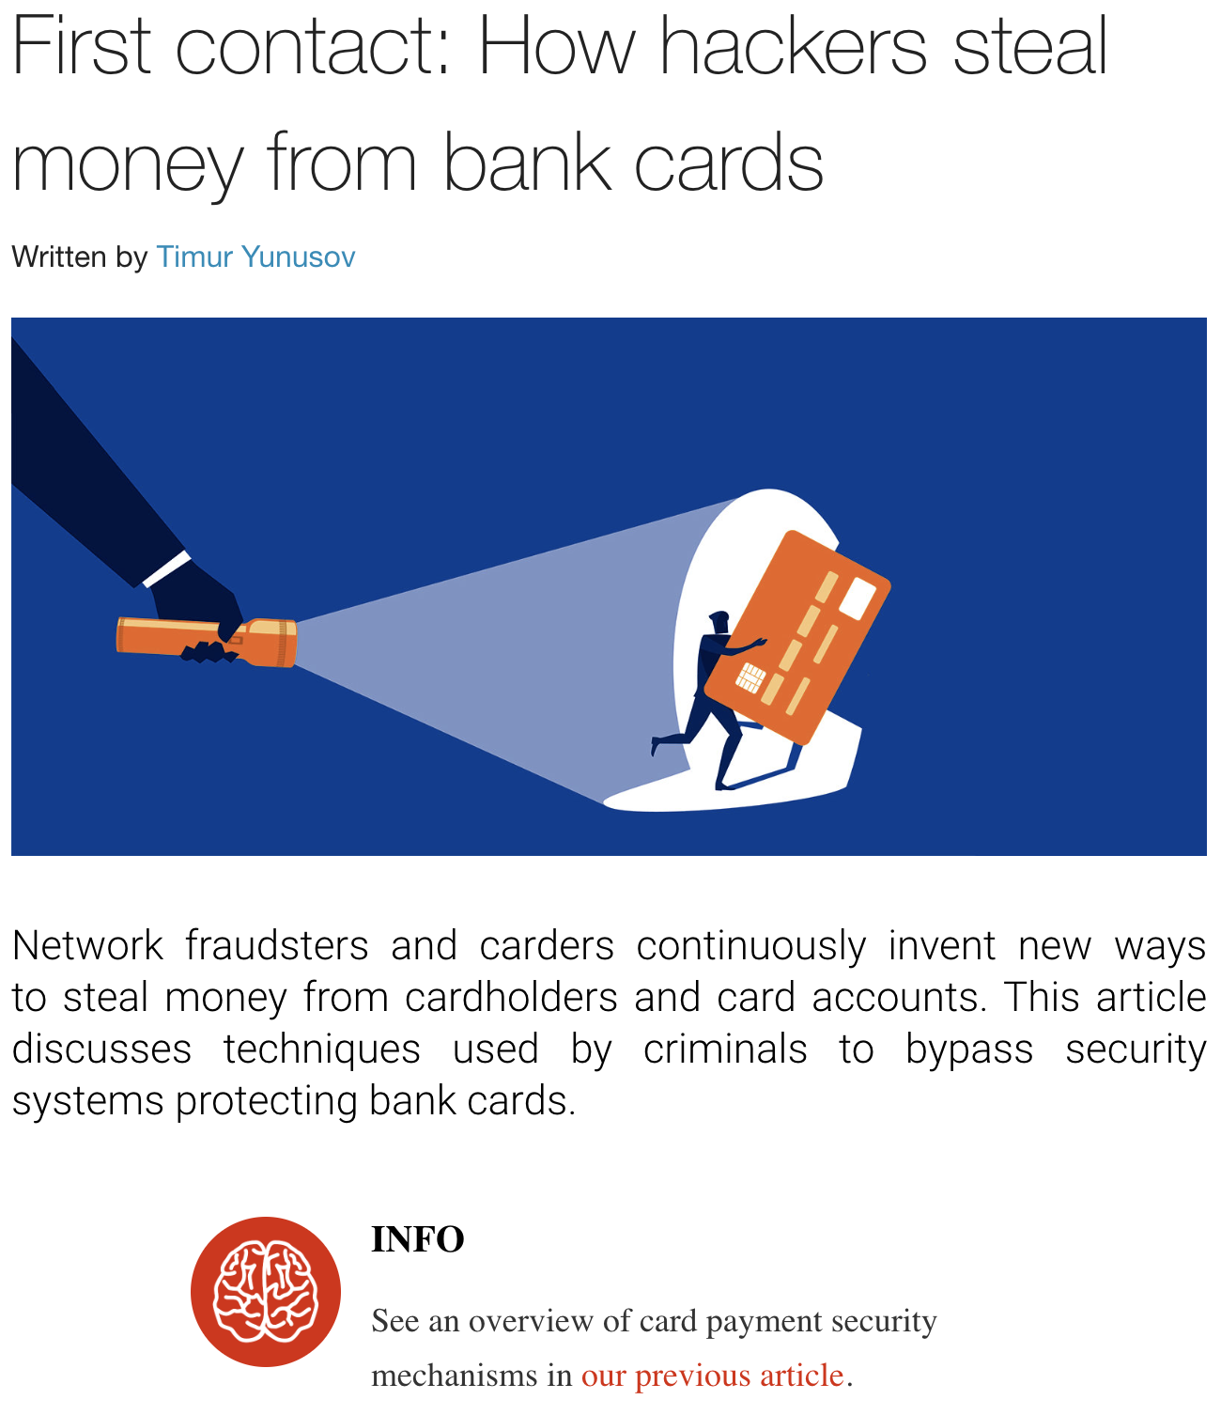
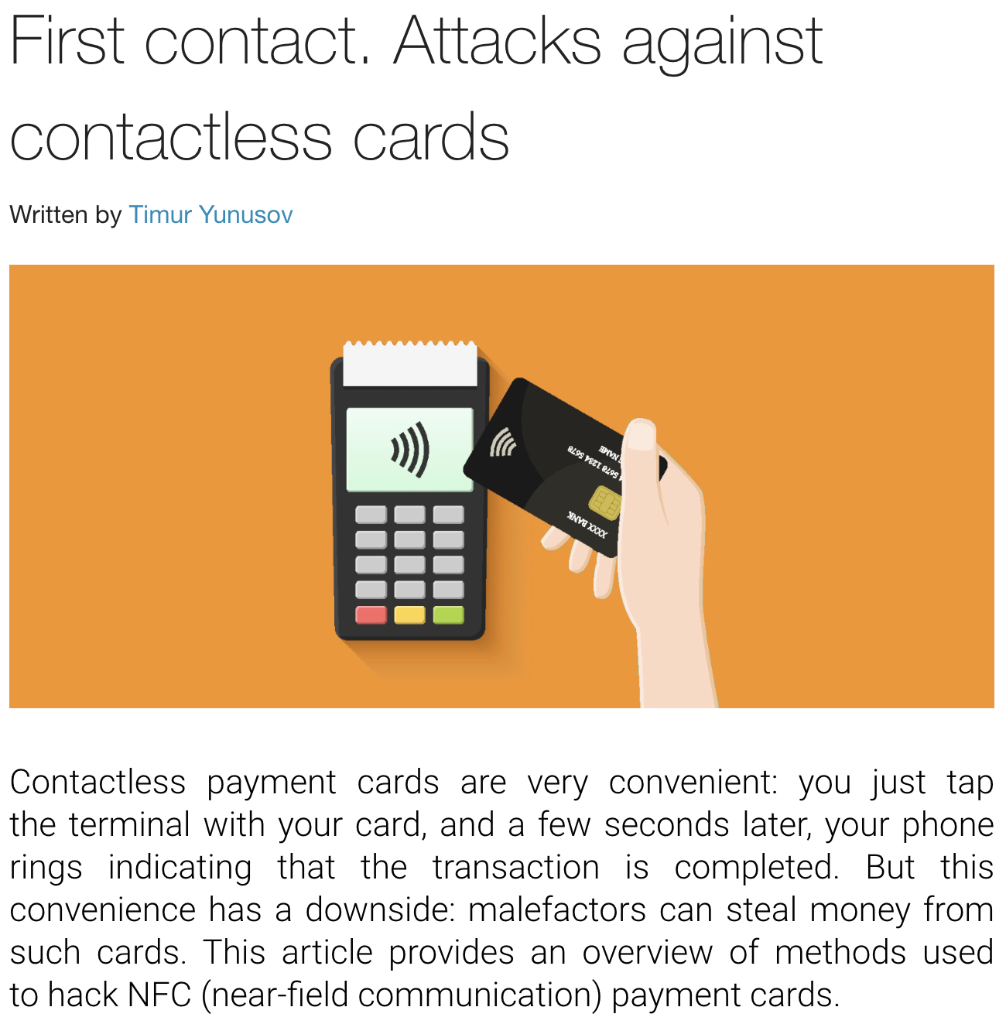
This is because the ISO8583 messages and authentication system is very vulnerable to fraud and false authorizations, and the industry expects to lose more than $400B USD over the next decade.
Due to the relatively insecure, and archaic infrastructure used to authorize and transmit card information, a myriad of attack vectors on ISO8583 messages exist, from “man in the middle” intercept attacks to placing malware on point of sale units.
The full breath and history of possible attack vectors is beyond the scope of this report. For the curious, we’d recommend the Hackmag series on payment card attacks. For the purposes of this proposal, it is important to note that any actor worldwide can easily conduct fraudulent transactions and wreak havoc, by just intercepting a single ISO8583 message or compromising a single terminal.
Notes:
https://www.paymentsdive.com/news/card-industry-faces-400b-in-fraud-losses-over-next-decade-nilson-says/611521
https://hackmag.com/security/credit-cards-history/

Slide 13
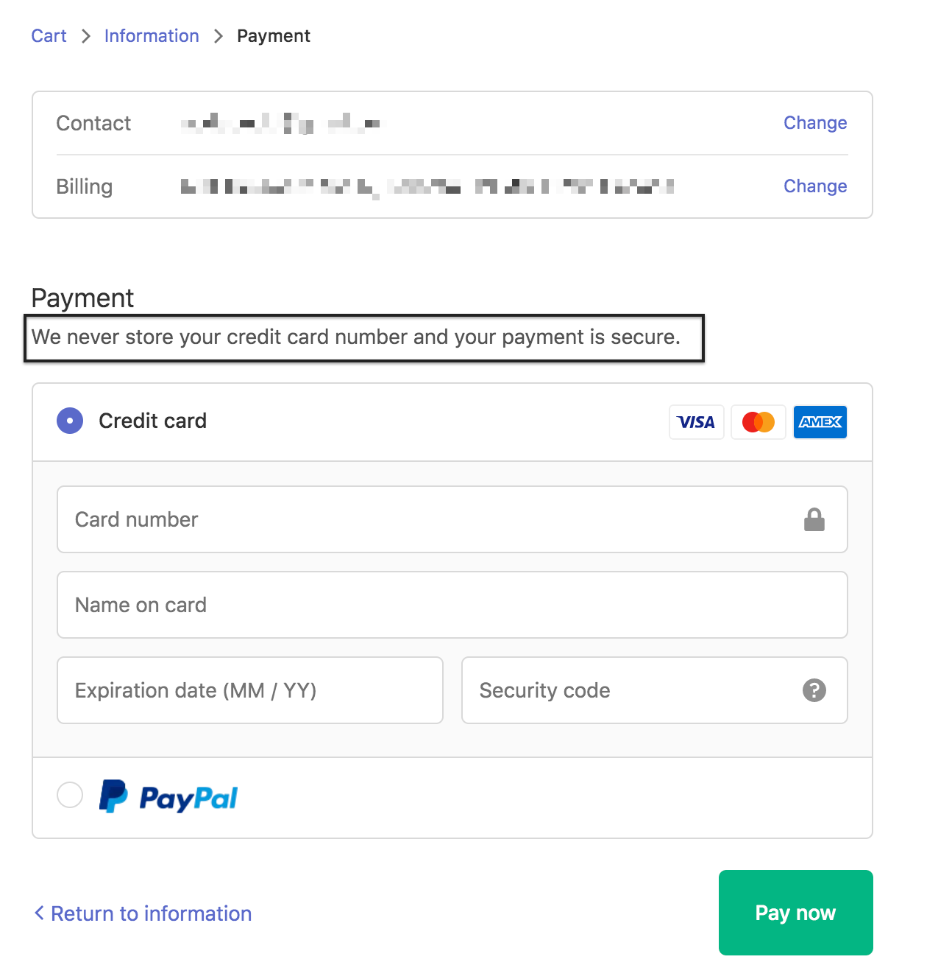
Payment cards don’t use public/private key cryptography. Instead, Authorization is dependent on only a few fields, all of which are present that ISO8583 message we showed earlier.
The card number, expiration date, and CVV are oftentimes the only information a sophisticated attacker needs to commit fraud.
Track 1 data fields (including full name) are stored in field 45
PIN numbers are usually stored in field 52
CVV number or the security code is usually stored in field 61
Notes:
https://medium.com/@mohammad2603/tools-for-a-iso-8583-developer-7709bcae9e5a

Slide 14
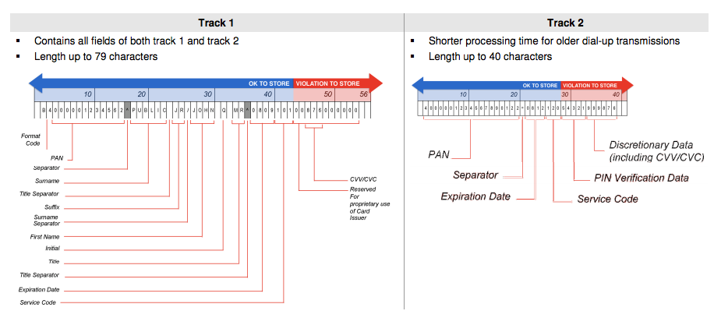
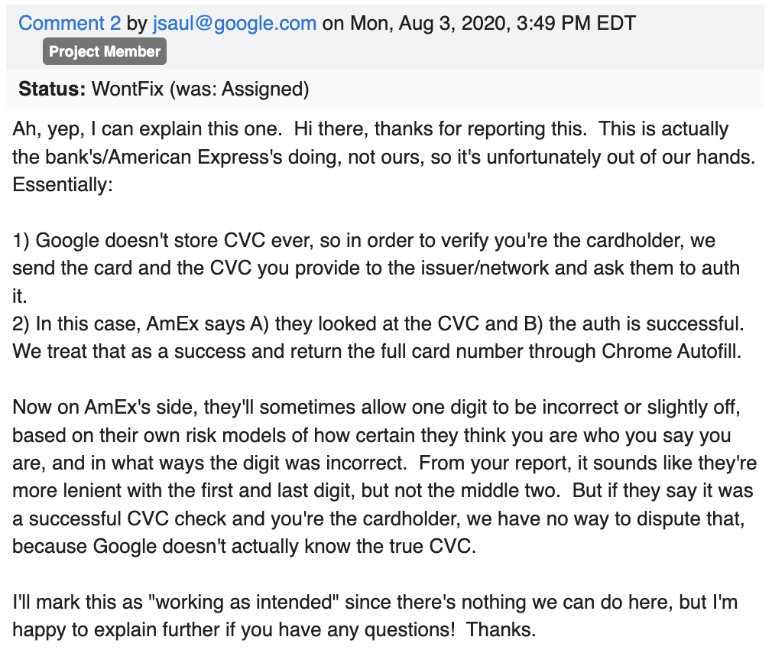
Even your browser won’t save the CVV/CVC/PIN number in autofill as it’s against the TOS for any company outside of the issuing bank to store that information.
Intermediaries can only store certain, limited information related to the transaction.
Google itself never saves that information, that’s why security codes are never auto-populated in payment forms.
While the user’s name and card number itself can be saved for archiving transactions, companies are banned by the terms of service from saving the PIN or CVC/CVV number associated with a card.
That being said, the actual way browsers populate credit cards is to authorize your card when you autofill them. It’s likely that the browser also provides additional location, site, and other usage fields to the bank to help them distinguish between legitimate and fraudulent uses of a payment card. As a tangent, the reason for Amex’s “wiggle room” isn’t due to a fraud model, it’s likely for compatibility. Amex CVVs are 4 digits while industry standard is 3.
Notes:
https://www.nuix.com/blog/howd-they-do-part-2-you-stole-my-credit-card-number
https://bugs.chromium.org/p/chromium/issues/detail?id=1112057

Slide 15
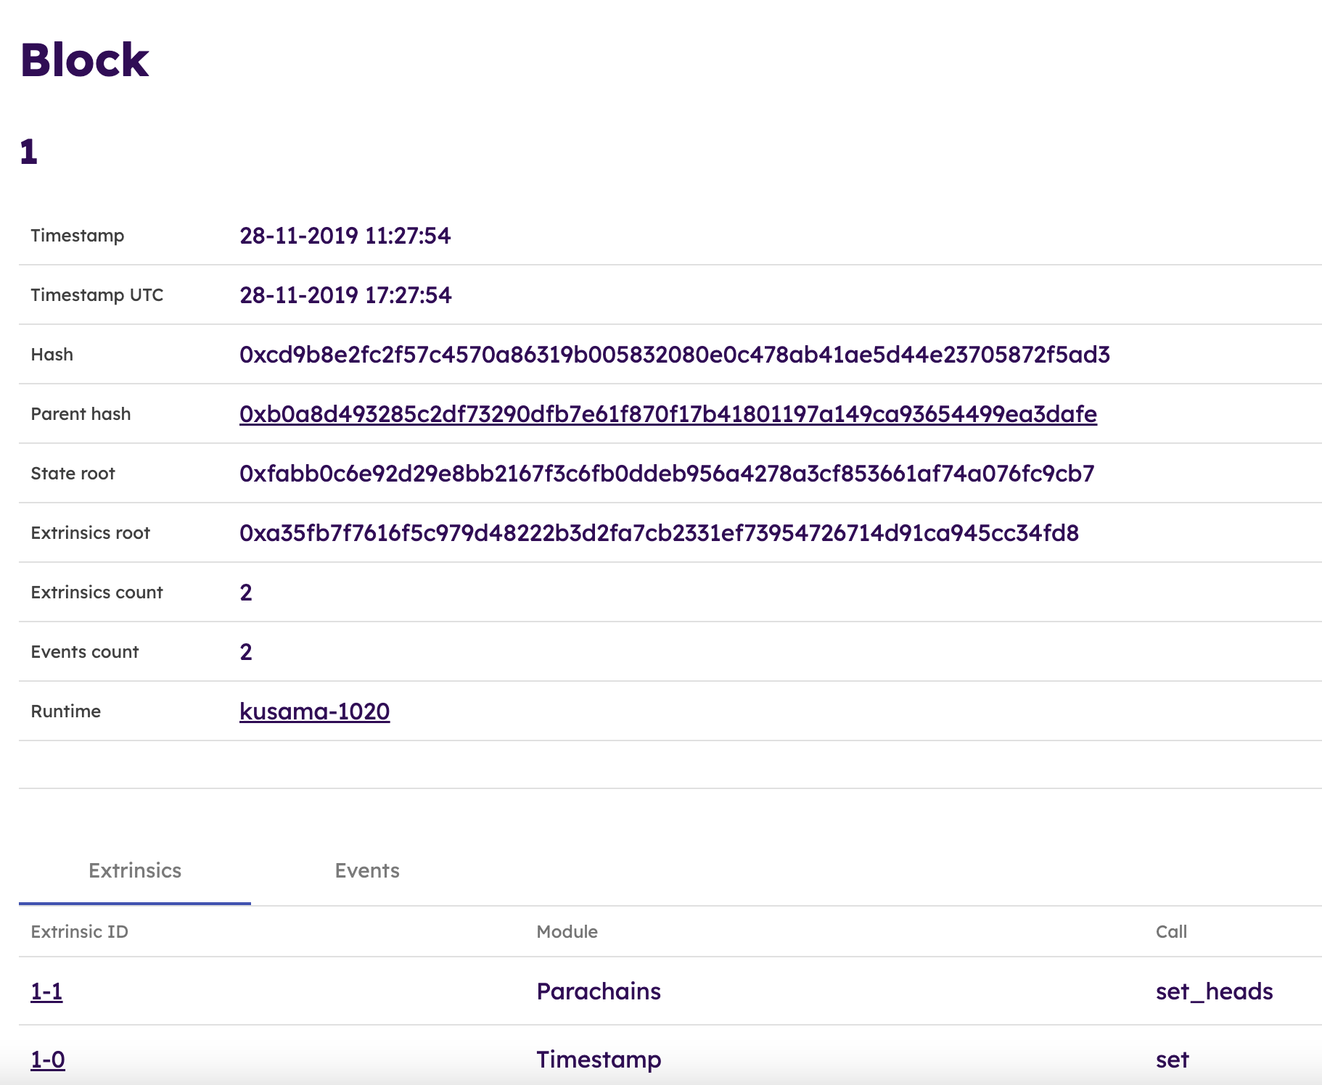
The open, eternally persistent, permissionless nature of blockchains possibly makes it the worst network architecture for transmitting or processing ISO8583 messages, even if they were encrypted.
Data on blockchains can be retrieved at anytime through an RPC call and is is permanently stored in order to prove the provenance of the chain.
Placing any ISO8583 message on the chain is a significant security risk.
Permanent Storage:
By its very nature, blockchains are immutable and permanently stored, meaning that sensitive transactions will persist on-chain for as long as the network exists.
No Access Control:
Permissionless networks and RPC protocols allow anyone in the world to directly access the details without any controls or restrictions.
Lack of Encryption:
All peer nodes need to be access and validate the information of the blockchain in order to update their own ledgers and arrive at consensus about the state which limits encryption techniques.
Legal Liabilities:
Some US and European States legally obligate companies to expunge all financial card data after a given time period.
Here is the Polkadot genesis block including all of the raw data. For obvious reasons, any ISO8583 information included into the ledger would be a potential liability and security hazard. A robust implementation needs to prevent even encrypted ISO8583 messages on chain.
The reason blockchains cannot employ an encrypted data standard is that all nodes need to be able to execute the message’s payload in order to maintain consensus. Even if you set up a private network with a secure key (also referred to as a permissioned network), if that key was ever leaked, a malicious actor would be able to retroactively decrypt all of the ISO8583 messages, retrieve the account and authorization information, and use the PAN numbers to commit widespread fraud.

Slide 16
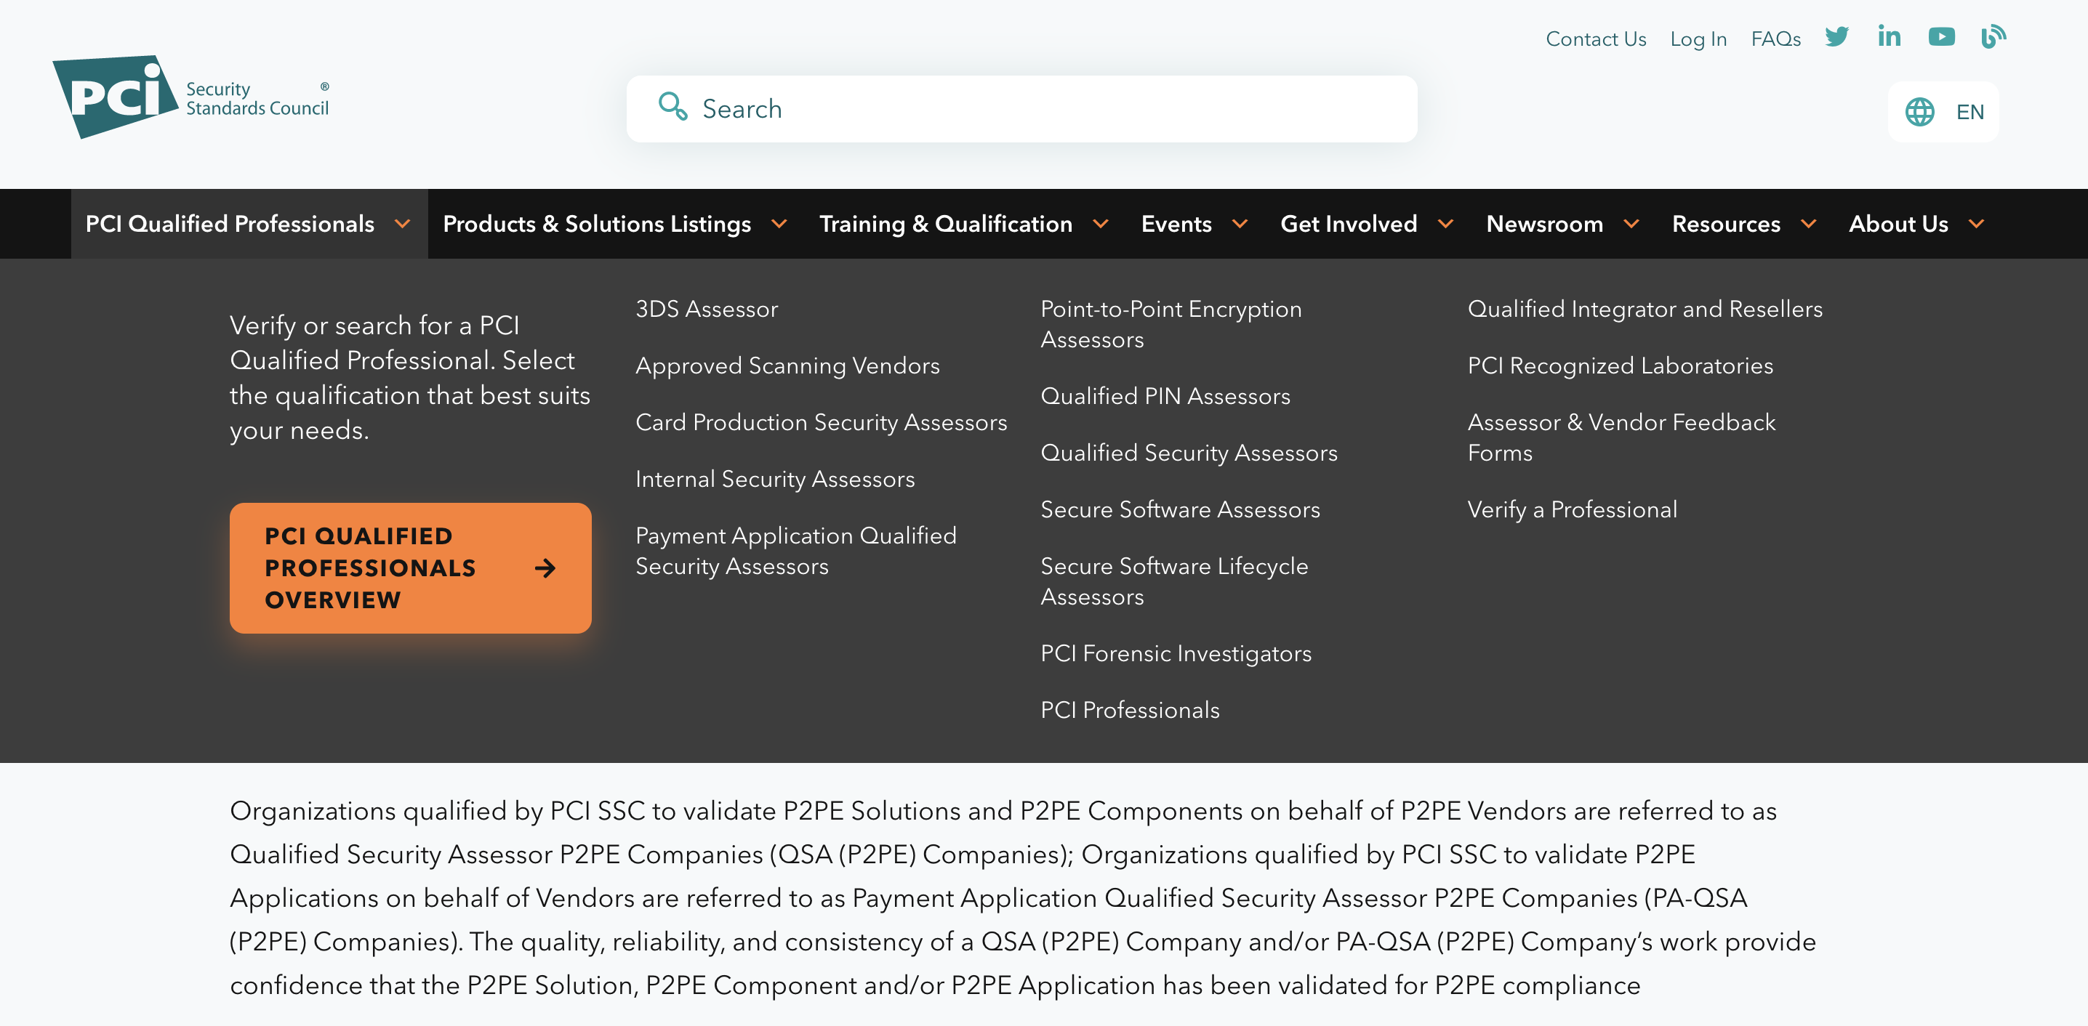
Compounding these challenges are the strict requirements of Payment Card Industry Data Security Standard (PCIDSS) compliance required for most financial applications.
PCIDSS is designed to reduce fraud and improve security. Compliance is rather arduous to achieve and must be evaluated ever quarter.
Though PCIDSS is not required by US Federal law, it is de facto necessary.
State Laws:
Several states have language specifying that every firm in the card payments chain be PCIDSS certified or at least conform to its specification.
Business Insurance:
In the case of a breach, PCIDSS compliance has a material impact in many jurisdictions on an indemnitee's liability. In some cases, PCIDSS may even provide prosecution immunities or other legal protections.
Terms of Service:
Many if not most networks and financial firms mandate PCIDSS compliance in their terms of service for all partners, vendors, and suppliers.
Public Perception:
Despite the fact that consumers in the US and EU are largely protected against unauthorized use of their cards, it isn’t perfect, and consumers are very sensitive to the security of their financial information.
Notes:
https://listings.pcisecuritystandards.org/assessors_and_solutions/point_to_point_encryption_assessors

Slide 17

Unlike blockchains, traditional payment networks are explicitly centralized and have several privileged actors who can make and impose unilateral decisions governing transactions or the network.
Blockchains have famously flat topology where every node is an equal peer in the network with equal privileges.
In traditional payment networks however, MasterCard and Visa are king and the merchants have limited recourse.
Complete Authority
Issuing Banks
Final Arbiters in Disputes
Payment Processors
Can Initiate Transactions
Merchants
Can Accept Payments
Networks

Slide 18
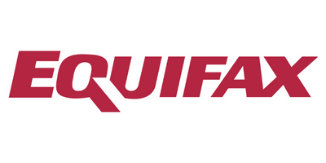



This is a challenge to adopt on modern blockchains architectures through cryptography as a breach of the centralized player’s privileged private keys might collapse the entire network.
Assigning account privileges on-chain is a poor solution as the financial industry regularly get’s breached and is certain to lose control of keys.
Depending on which key is breached, the impact could be catastrophic.
Network’s Private Keys:
A breach in the network key on-chain would be catastrophic. It would basically allow the attacker to gain full control over the network and issue fraudulent transactions unilaterally causing complete network collapse.
Issuing Bank’s Private Keys:
Losing control of an issuing bank’s key is slightly less problematic, however it would allow a user to reverse transactions to their own personal benefit. This would likely come with significant random reversals as well to disguise their identity quickly eroding confidence in the network.
Payment Processor’s Private Keys:
Even if data is stored in an encrypted form on-chain, a breached payment processer key would allow the attacker to read all the PAN numbers since inception. If data is kept off-chain this key could allow an attacker to initiate and possibly perform fraudulent transactions.
147M Credit Profiles
Failed to patch a well-known vulnerability Apache Strusts
885M Credit Card Applications
A simple oversight on webpage access control.
100M Credit Card Applications
Cloud data stolen by an AWS employee
130M Credit Card Numbers
SQL Injection and Physically Stealing Computers
Historic attacks have ranged from Russian hackers, disgruntled AWS employees, to attackers simply stealing physical hardware. There are simply too many attack vectors to assume even the most secure banks in the world can maintain operational security of their private keys. It is better to assume every network participant will lose their keys at some point and will require a recovery mechanism.
Notes:
https://www.upguard.com/blog/biggest-data-breaches-financial-services

Slide 19
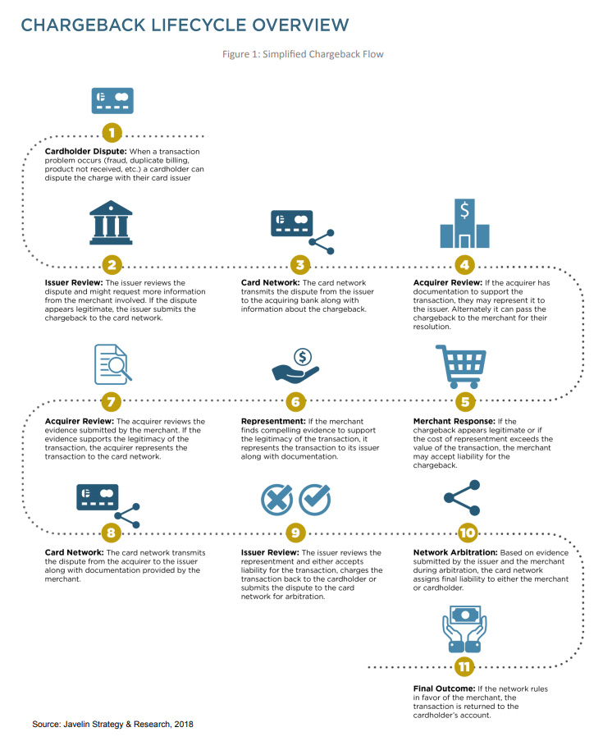
Adapting these responsibilities to a peer to peer structure doesn’t work as members of the network must respond to a unilateral, centrally mediated fraud process when it comes to reversals.
Fraud disputes are a complex process that involves both manual reviews and network arbitrations.
This chargeback process was something that Satoshi was attempting to solve in the original Bitcoin implementation.
Transaction Finality:
Transactions on every blockchain are final as the computed hash is what allows the network to maintain consensus. One of the key principles of Bitcoin’s original implementation that it has maintained to the present is that transactions are final and there is no way for the initiating wallet or any wallet other than the receiving user to reverse the transactions.
Challenges with Escrow:
Satoshi envisioned Escrow accounts being used to manage a reversal process, however the use of escrow accounts is itself problematic as it would lock up otherwise productive capital for significant amounts of time. In addition, it still falls on a centralized entity to mediate whether or not the terms of the escrow payment were fulfilled if the transaction involved off-chain information.
Notes:
https://javelinstrategy.com/research/chargeback-triangle

Slide 20
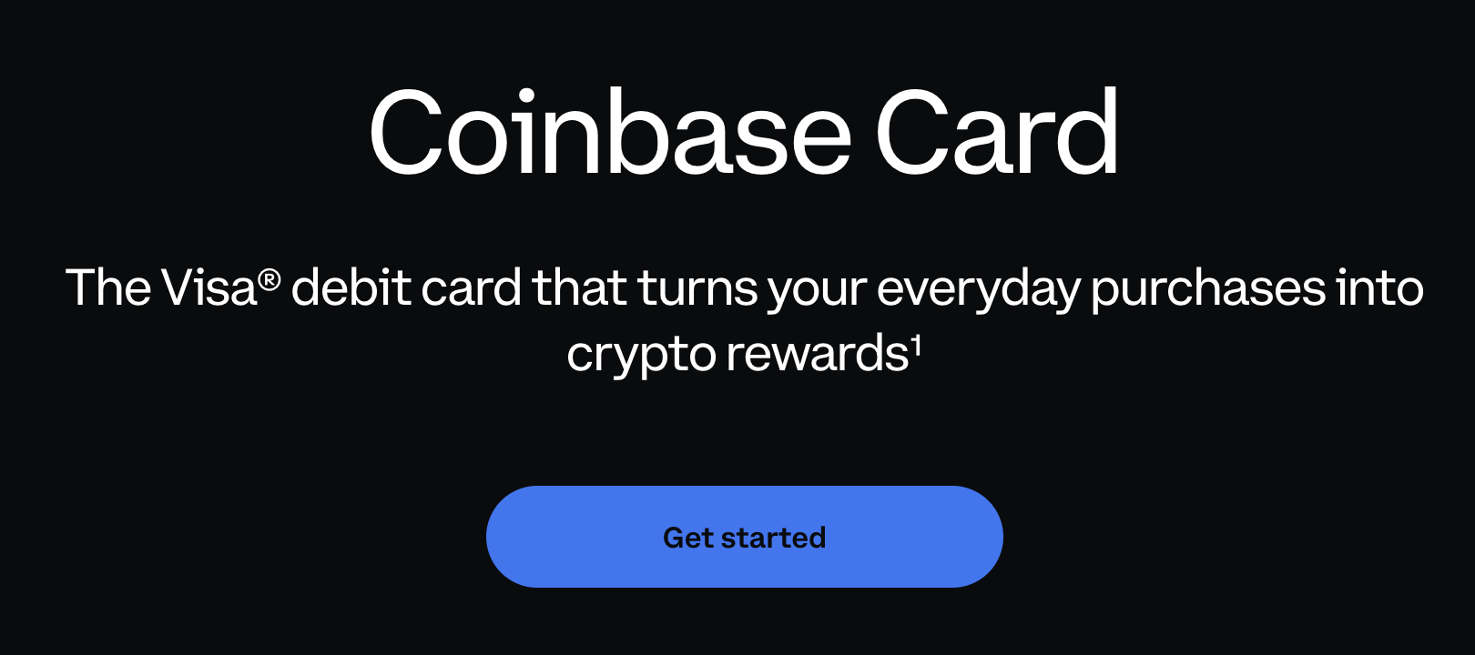
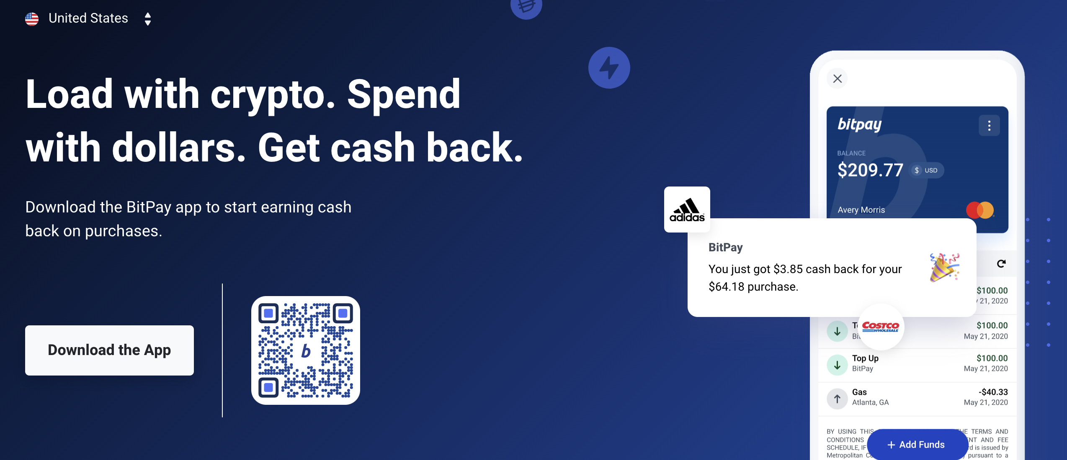
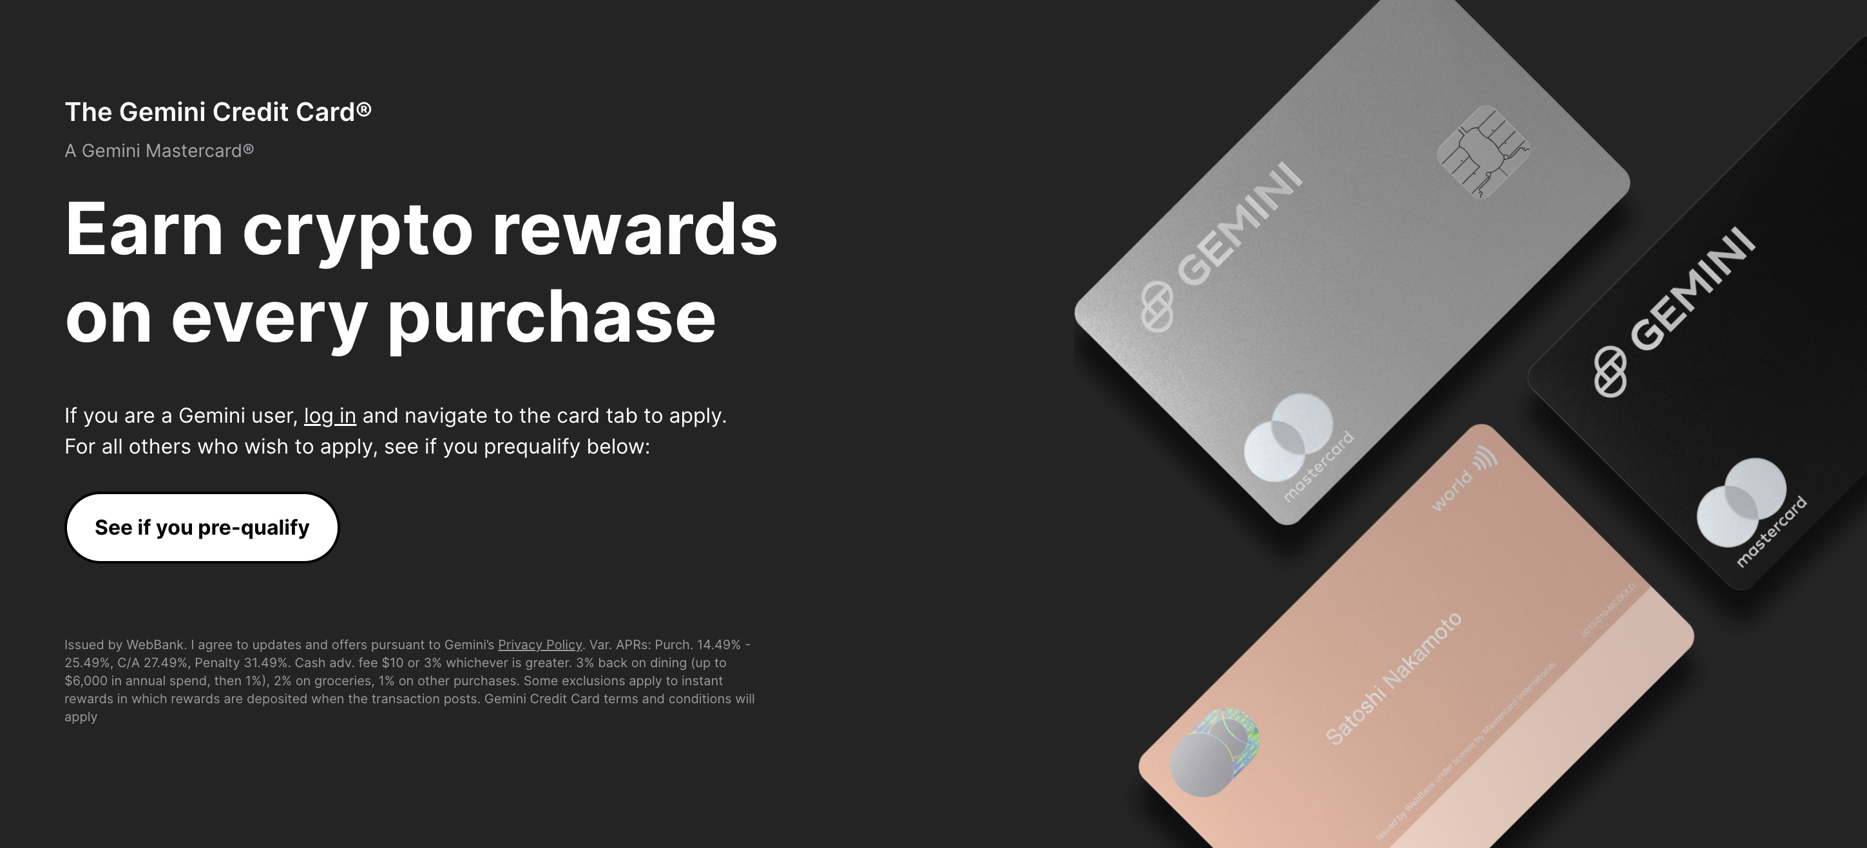
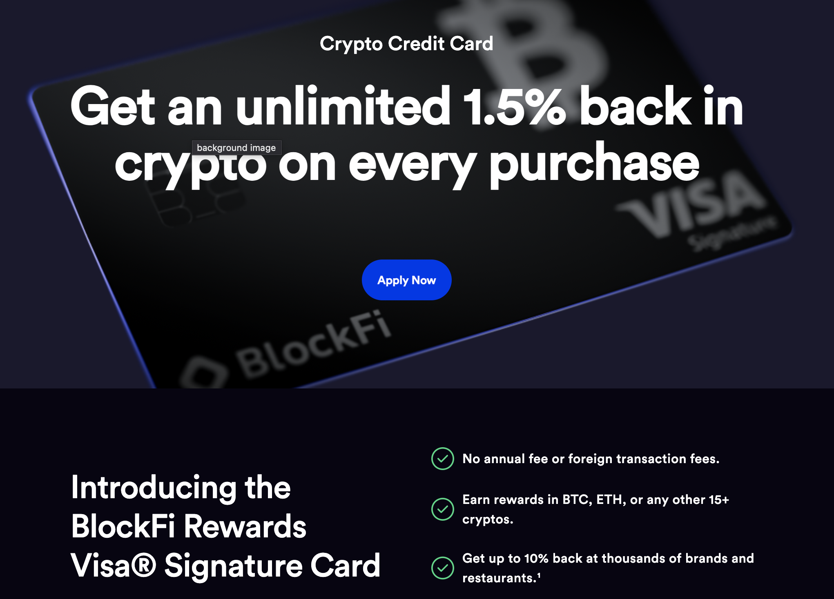
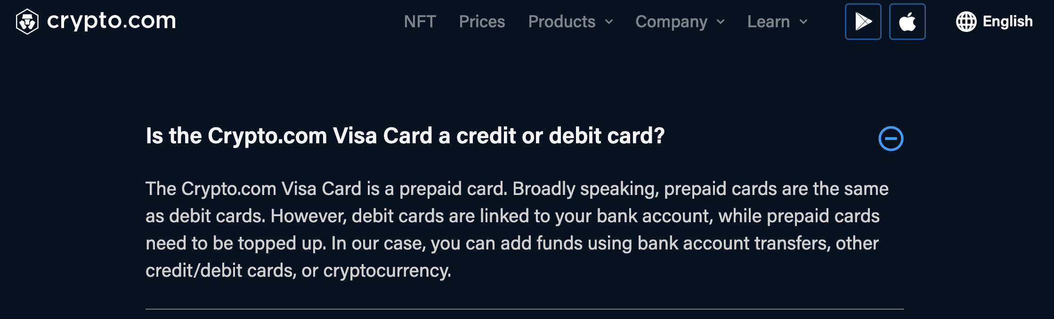
In terms of attempted and in-market commercial products, most “crypto-related” payment cards have no direct or indirect exposure to the blockchain.
These cards range from regular credit cards with cryptocurrency based rewards issued by traditional banks..
..To simple pre-paid debit cards, where the exchange automatically sells your crypto and loads the cash balance to a debit card.
Gemini Credit Card
Blockfi Credit Card
These credit cards are traditional products, white labeled, underwritten, and administrated by a traditional chartered bank. The main blockchain connection, is the exchange provides the rewards in tokens instead of cash. This benefits all parties as the banks profit off of underwriting the loans, and the exchanges gain additional users. In addition for every transaction, the issuing bank and exchange receives ~2% of the purchase as a fee, called interchange. This interchange funds the reward, and any additional excess is direct profit for the bank and exchange. These accounts are completely separate from the blockchain, and do not reference any ledger addresses.
These debit cards are even more straight forward. Best though of as a gift card, these payment cards are simply loaded with cash by the exchanges by selling your crypto currency. This balance is then available to spend as it’s held in cash by MasterCard or Visa under their prepaid accounts. There is no direct connection to the blockchain as the exchange has all of the assets pooled under their own addresses.
Notes:
https://crypto.com/us/cards
https://www.gemini.com/credit-card
https://www.coinbase.com/card
https://bitpay.com/card/
blockfi.com/credit-card

Slide 21
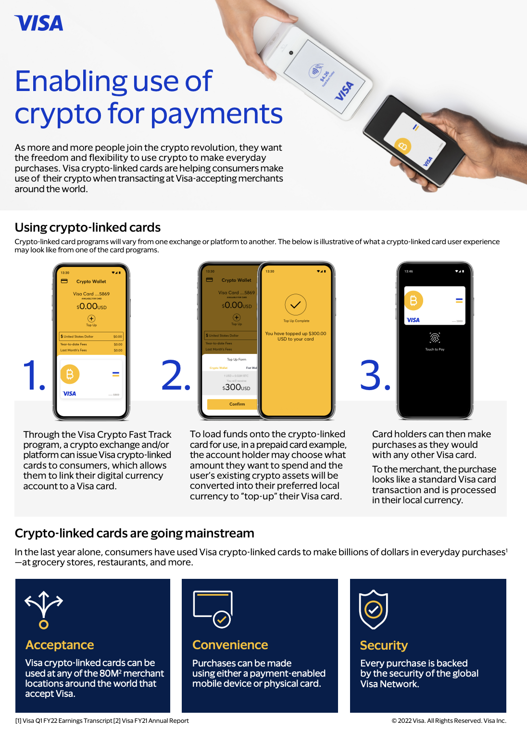
These products are simply traditional products with a blockchain veneer, and lack any integration. They serve primarily as a way for incumbent networks to capitalize on blockchain’s brand.
VISA and Mastercard are attempting to push these traditional white label cards in an effort to prevent users from adopting truly native blockchain based card payment systems that can be used independently of their network.
We are also providing on-ramps for crypto players creating connectivity with fiat economies. There are over 65 crypto platforms and exchanges that have partnered to issue Visa credentials. This quarter, Visa credentials in crypto wallets had more than $2.5 billion in payments volume, which is already 70% of the payments volume for all of fiscal 2021.
In addition to embedding credentials in crypto platforms, we continue to innovate around our settlement and crypto API capabilities which have been key differentiators for us for fintechs and financial institutions that are looking to extend crypto capabilities to their customers. We will continue to lean into the crypto space and our strategy is to be a key partner to provide the connectivity, scale, consumer value propositions, reliability and security that is needed for crypto offerings to grow.
Earlier this month, we previewed CBDC payment APIs currently in development which would enable central banks to connect their Ethereum-based CBDCs with Visa rails through a wallet with digital issuance capabilities enabling consumers to spend with CBDCs at any Visa merchant. We partnered with ConsenSys to develop this concept which was selected as one of the winning entries out of 300 ideas from 50 countries at the global CBDC challenge as part of the Singapore FinTech Festival judged by representatives from the IMF, the World Bank, the Bank of International Settlements (sic) [Bank for International Settlements] (00:07:34), and the central banks of Brazil, India, Kenya and Indonesia.
VISA Q1 2022 Earnings Call
Notes:
https://crypto.com/us/cards
https://www.gemini.com/credit-card
https://www.coinbase.com/card
https://bitpay.com/card/
blockfi.com/credit-card

Slide 22
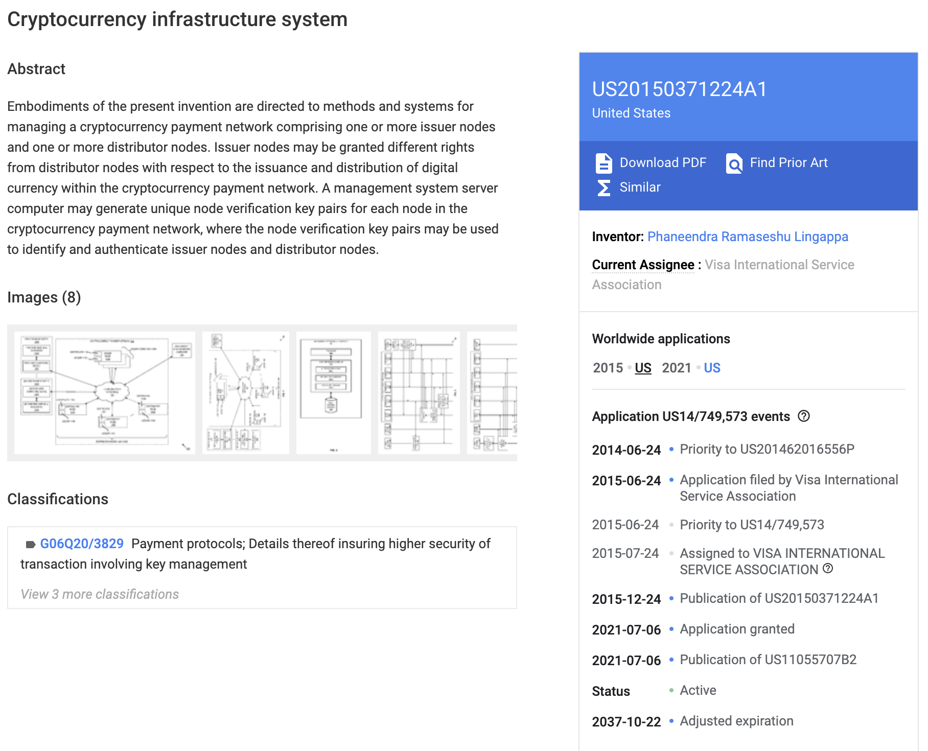
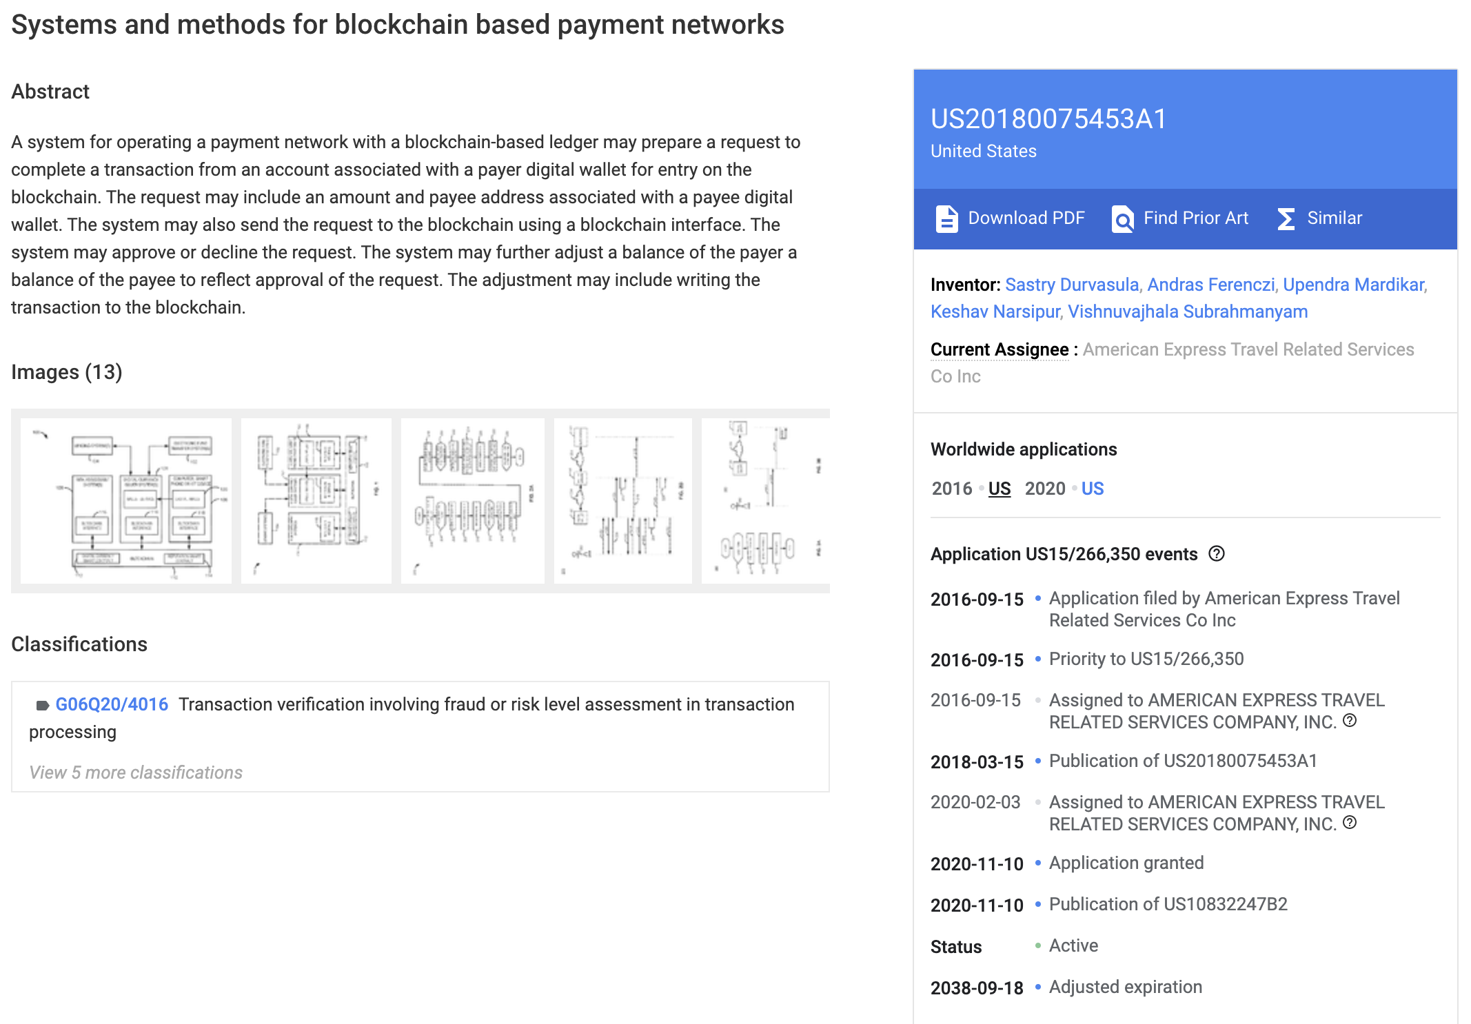
These incumbent networks and financial institutions have patented most applications in the space, though these patents seem overbroad and their validity and protections remain untested.
For example, VISA owns the patent for all cryptocurrency infrastructure systems in general in the US.
And American Express owns the patent for operating a payment network on a blockchain based ledger.
Disclaimer this is not legal advice, for full clarity please consult a lawyer in your jurisdiction. In our non-legal opinion, these patents are overly broad and likely unenforceable. Cryptocurrency infrastructure has been around well before VISA “developed” it 2014, and users have been using the blockchain to facilitate payments prior to America Express’s ”innovation” in late 2016. Any competent legal team should be able to find prior art of both use cases, and invalidate these patents. It is likely this is why neither of these patents has ever been attempted to be enforced despite the large number of “infringing” firms and projects. Actual patent litigation in the blockchain space has been incredible rare, and these patents seems to be largely untested.
Notes:
https://patents.google.com/patent/US20150371224A1/
https://patents.google.com/patent/US20180075453A1/

Slide 23


While directly sending or processing ISO8583 messages on an open P2P blockchain is impossible from a security perspective, we may be able to clear them elsewhere and settle the transactions on-chain.
Ultimately, the goal of any successful ISO8583 integration is to allow users to access their on-chain balance, and spend it at any merchant that accepts payments cards worldwide.
?
Card Swipe
ISO8583
On-Chain Balance
Substrate
We may be able to enable this by centralizing key functions, however this centralized entity will also have to solve the key problems of information security, authority and its recovery, and reversals.

Slide 24



We propose using an oracle to simultaneously allow users to manage their funds like any ERC20 token while accepting and processing ISO8583 messages.
This architecture allow users to perform wallet-to-wallet transfers on chain like any ERC20 token with their private key, while allowing a centralized company to securely process ISO8583 messages and authorize them on the chain.
User Action
e.g. Card Swipe
Traditional Networks
PCIDSS* Company
Authorization Oracle
Specialized Smart Contract
Here traditional networks send their ISO8583 messages to a specially setup PCIDSS-compliant company. This company processes the transaction and issues it for settlement through an authorization oracle. This allows the company to recover from breaches, arbitrate reversals, comply with payment regulations, and withhold sensitive ISO8583 details from being sent directly to the blockchain.
* PCIDSS is the set of standards that any company storing or processing payment card information is required to comply with.

Slide 25


This allows both payment networks using ISO8583 and users to issue transactions out of their accounts and conduct on-chain actions safely.
The company accepts ISO8583 formatted transactions off-chain, verifies the authorization, and issues on-chain actions through an authorization oracle.
This allows us to maintain information control and provides recovery options.
Card Payment Networks
Specialized Smart Contract
PCIDSS Company:
The card networks and financial firms send their ISO8583 messages to a specially setup PCIDSS company for processing. This company is responsible for processing ISO8583 messages, issuing responses, controlling data security, preserving PCIDSS compliance, and maintaining the registered bin number for message routing on the payment networks.
API Driven Oracle:
On-chain smart contract transactions can be initiated by a user for any account balances that isn’t possibly reversable, or the oracle. This oracle is controlled by the PCIDSS company and provides control for reversals and on card network payments.
Recovery:
This eliminates the reliance on private keys. If the holding company’s infrastructure is breached, there are several established ways to prove identity to the cloud server provider to recover control of the oracle’s domain.
Agency:
As a blockchain native solution, users have address and keys and as such can directly manage their funds without needing to route payments through traditional financial networks.
Transaction Initiations
Payment Processors
Authorization Oracle
Instantiate Account
Reversals
Visa/Mastercard
PCIDSS Company
Reverse Transaction
Account
Queries
Issuing Banks
Full Duplex Communication
Simplex Communication
Transfer

Slide 26

The high degree of centralization of an oracle allows us to; hide ISO8583 information behind a privacy barrier, comply with PCIDSS requirements, and manage transaction authorizations in real time.
Payment gateways and networks ultimately route ISO8583 messages to the financial company that controls the oracle just as they would any other firm.
The PCIDSS Company also helps smooth transaction and data flows.
Information Security:
The most important functions of the PCIDSS company are to censor ISO8583 transactions and perform authorization checks before it sends the transaction to the oracle to be placed on-chain. This allows us to hide all authorization info and account numbers, as well as destroy the information after performing the transaction. This is needed to comply with current state and future federal government regulations on payment card information security.
Realtime State Information:
As the PCIDSS Company has control over the authorizing oracle, pending transactions and insight into the current state of the blockchain, it’s able to verify account balances and perform real-time authorizations of funds, a requirement for use on payment card networks.
Sole Source of Truth:
The company also maintains a real-time record of the blockchain’s state along with pending transactions to ensure an accurate understanding of a user’s financials at any given time.
Financial Firms
Specially Set up PCIDSS Company
Oracle
Blockchain
Data Queries
One Way Information Barrier
The only way the blockchain receives ISO8583 transaction information is through the oracle. This allows us to hide sensitive details like account numbers and authorization codes that are contained in the payload of an ISO8583 transaction. The PCIDSS compliant company also allows us to perform data queries on-chain to keep an up to date record of the ledger to perform balance checks necessary for real-time authorizations.

Slide 27






At a high level, here is the comparison between traditional networks and through our proposed oracle-based authorization flow.
Authorization requests are routed by BIN number and are sent to either the issuing bank or our company for a response.
Merchant
Amazon.com
Traditional Network
Stripe/MasterCard
Issuing Bank
Chase
Payment Processer
Stripe
JSON, XML or
Custom API
ISO8583 or
AS2805
ISO8583 or
AS2805
Visa
Mastercard
Discover
A user presents their card or card details at an authorized accepting merchant.
The merchant sends it to their payment processor
The payment processer formats the message into ISO8583 and forwards it through the appropriate network to the card’s issuing bank.
The issuing bank verifies the card details and authorization information and makes an approve/decline decision. It then sends this message back through the network.
After the response reaches the payment processer, they are forwarded to the merchant, but all the approvals are stored for the settlement process.
Merchant
Amazon.com
Traditional Network
Stripe/Mastercard/Substrate
Oracle Company
PCIDSS Company
Substrate Blockchain
Polkadot
JSON, XML or
Custom API
ISO8583 or
AS2805
ISO8583
or AS2805
Substrate
+
These cards would be specially issued by the Oracle company to tie their PAN number to a blockchain address.
It is then processed normally.
The payment processer formats the message into ISO8583 and forwards it through the network which routes to the PCIDSS company.
Here the specially setup company checks the balances on-chain and the pending transactions to verify that a user has sufficient funds. It issues it’s own ISO8583 formatted approve/decline message and a substrate transaction.
The response is not only sent to the payment processer and merchant, but the transaction is also queued on the oracle for settlement on the blockchain.
Substrate Transaction

Slide 28






Here is that same flow for our proposed oracle solution in deeper technical detail.
The full flow is significantly more complex, however despite this backend complexity, the process is seamless from the user’s and merchant’s point of view and the customer experience is exactly the same as using a generic bank issued payment card.
Start
Visa
BIN 511375 (to Chase)
Mastercard
BIN 549191 (to BOA)
Discover
BIN 550201 (to Citi)
ISO8583
Auth Message
The Payment Gateway routes the request to the appropriate network based on the first digit of the BIN number*.
ISO8583
Auth Message
User enters their virtual card number/swipes their physical plastic card.
API Call
The merchant submits this information to a payment gateway
This network then routes it to the corresponding institution based on the BIN number*
End
ISO8583
Response
Approved
Decline
BIN ******
(Route to the oracle holding company)
ISO8583
Auth Message
If the merchant has a blockchain account, tokens are moved on the blockchain for immediate settlement. (Long-Term Goal)
Internal Data Processing
If there is not, it rejects the transaction and broadcasts a ”decline” response back to the merchant.
The company checks the ledger and approved pending transactions to see if there is sufficient balance.
Internal Data Processing
Here, it is routed to the oracle holding company’s BIN.
Substrate Transaction
Otherwise, the tokens are reclaimed by the oracle holding company’s account which then settles the transaction through the nightly settlement process.
(Immediately Implementable)
If there is, it queues the transaction using the oracle for on-chain execution and sends an “approved” response to the merchant.
* The BIN (Bank Identification Number) is the first 4-6 digits of the card number that indicates key information such as the network that issued it, and the authorizing bank.

Slide 29
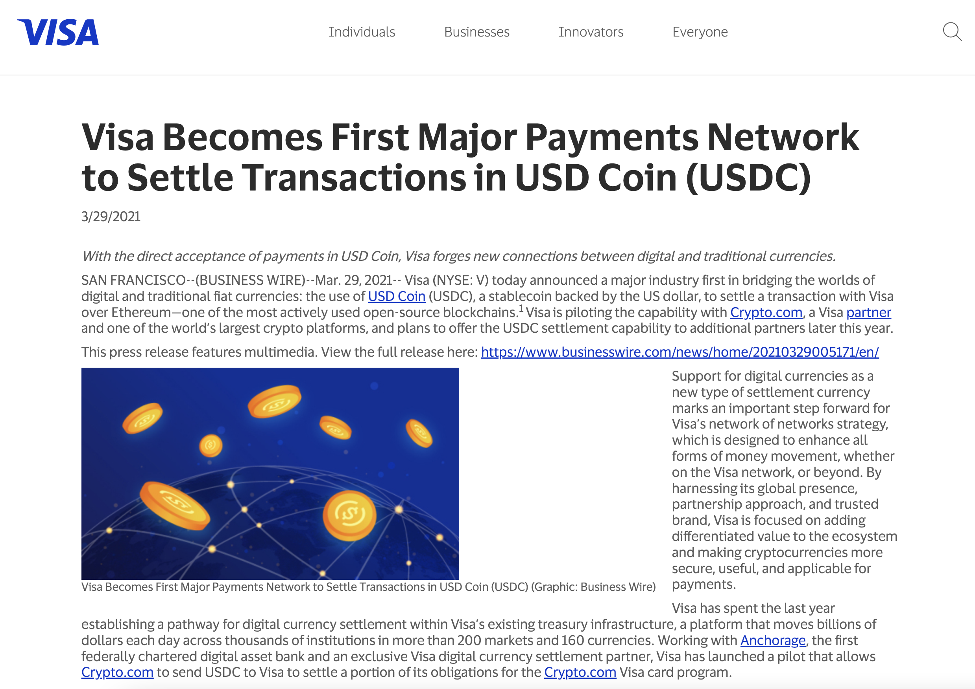
In order to minimize currency risks, it’s ideal if the smart contract tokens are some form of custodied stablecoins.
For the simplest implementation, the smart contract’s tokens would ultimately be backed by custodied assets (USD ideally) held by the oracle holding company, this allows them to easily be liquidated and used in the nightly settlement process.
There is precedent for using 3rd party stablecoins themselves to settle on VisaNet, VISA’s inter-firm settlement network. In 2021, VISA piloted the ability to settle in USDC by partnering with Crypto.com, though it didn’t see widespread adoption, and ultimately relies on a combination of Anchorage and Crypto.com to facilitate the redemption to USD to settle the debt. In our view, settling on VisaNet in crypto adds additional complexity and headache to the receiving partners on the network as they must now have separate systems to accept the settlement currency.
In our architecture, the oracle holding company simply reclaims the issued tokens and the custodied USD released is sent through VisaNet. This is significantly easier to implement than it probably seems at first glance as the settlement process is a batched process and is firm-to-firm for overall account imbalances and not performed on an individual transaction basis. The holding company only needs to audit the smart contract’s overall token balance to the custodied assets after every settlement process instead of auditing accounts and transactions individually.
Notes:
https://usa.visa.com/about-visa/newsroom/press-releases.releaseId.17821.html
https://usa.visa.com/visa-everywhere/blog/bdp/2021/03/26/digital-currency-comes-1616782388876.html

Slide 30
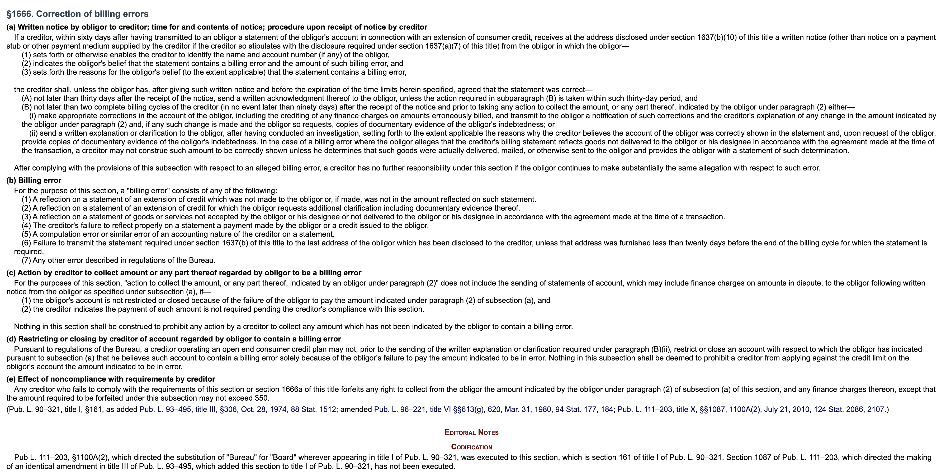
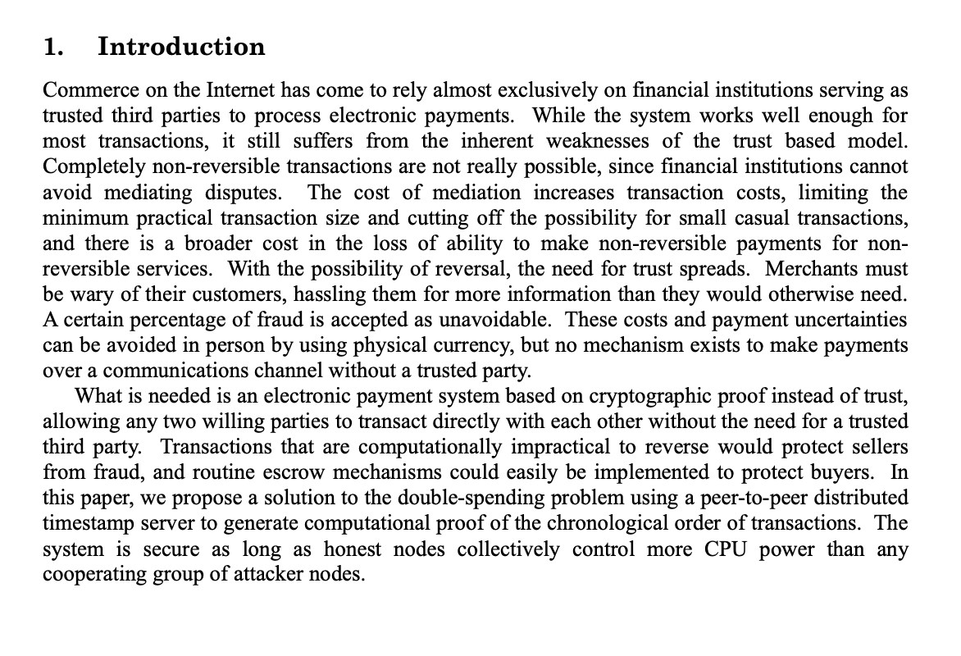
The oracle controlling company can also issue reversals as is required by law, though blockchain architectures and the ERC20 standard were not designed with this capability natively.
All payment card transactions, and therefore all ISO8583 transactions, must be reversable.
Blockchains are not reversible by design, chargebacks were viewed as a design flaw Satoshi attempted to address.
US, EU laws, the terms and service of VISA and MasterCard, and several regulatory bodies have stated in no uncertain terms that payment card fraud is not the liability of the consumer and those transactions must be reversible. A large portion of ISO8583 messages are related to transaction reversals.
Reversals and their effects compose nearly the entire intro of the original Bitcoin white paper. Chargebacks introduce uncertainty into the payment system and require a centralized entity to resolve. Decentralization and finality are key components of blockchains from their inception.
Notes:
https://usa.visa.com/pay-with-visa/visa-chip-technology-consumers/zero-liability-policy.html
http://uscode.house.gov/view.xhtml?req=granuleid%3AUSC-prelim-title15-chapter41-subchapter1-partD&edition=prelim

Slide 31
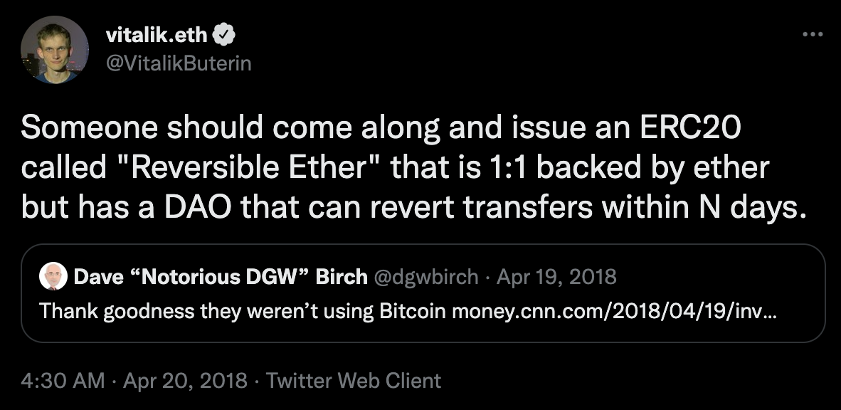
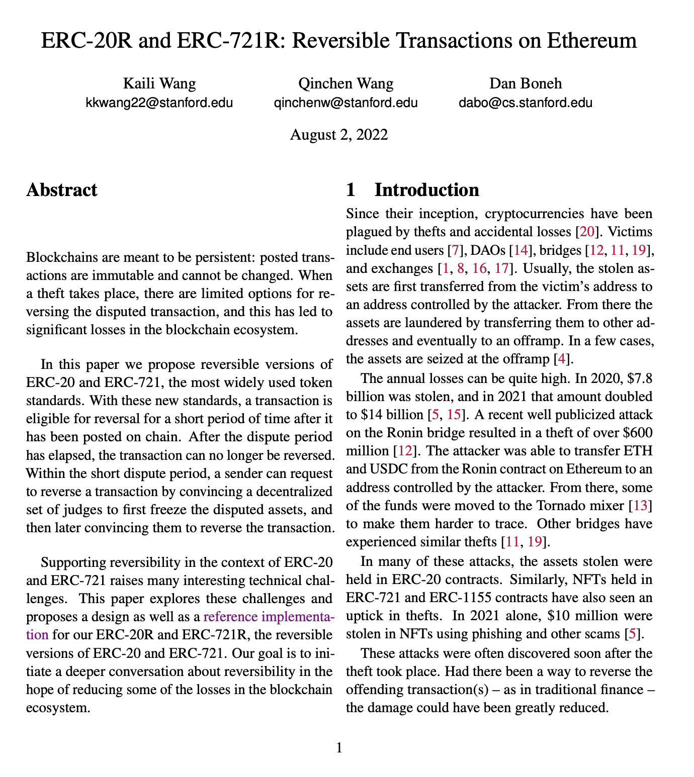
Luckily, reversibility is an area of active research and Stanford has just released its reversable ERC20R smart contracts. Though, these implementations are still on the untested cutting edge of technology.
The idea of reversable transactions on the blockchain isn’t a new idea and has been thrown around for years.
ERC20 implementations with reversal functions have recently been outlined in the latest research by Stanford.
ERC-20R and ERC-721R: Reversible Transactions on Ethereum
Published August 2, 2022 by Kaili Wang, Qinchen Wang, and Dan Boneh.
https://arxiv.org/pdf/2208.00543.pdf
Reversible ERC-20 or ERC-721 transactions are still at the cutting edge of blockchain technology. While seemingly simple, reversals actually introduce several significant engineering and economic challenges. Most of these challenges are still unsolved in decentralized trustless networks.
This proposed implementation from Stanford is largely in response to the recent large-scale bridge hacks, and has been designed to facilitate reversal disputes through a decentralized panel of randomly chosen judges. If the judges approve, the transaction(s) are reversed through a transaction. With a payment card reversal, the authority is relatively simplified, but the economics of reversing largely legitimate transactions down chain of the transaction is far more complicated.
Notes:
https://twitter.com/vitalikbuterin/status/987262267036184577
https://arxiv.org/pdf/2208.00543.pdf

Slide 32


There are a few key challenges a reversible ERC20 token must address. The Stanford implementation addressed authority and downstream impacts, but not capital efficiency.
Downstream Impacts
Reversing a transaction up to 90 days later has significant logistics challenges if those funds have been spent in the general transaction pool. Generally, funds can be pulled from an account as long as there is sufficient balance, however if that account has then spent the funds in legitimate transactions reversing those downstream has a strong negative impact on everyday users.
Authority
As fraudulent users, honest users, merchants and banks all have conflicts of interest and unaligned incentives, there is an outstanding challenge as to who holds the ultimate authority to reverse transactions.
Capital Efficiency
As any account can hold ERC20 tokens, one possible attack vector is to have a new fraudulent account that immediately cashes out into a non-reversable token. Some solutions might be requiring users to post collateral or a holding period before which moving tokens out of the smart contract is not possible, however both solutions are very capital inefficient.
Traditional Financial Market Solutions
As transactions are not settled on a 1:1 basis, but rather aggregated into a nightly settlement, any reversals are also aggregated and the account holder is required to keep a sufficient balance in their account to cover any potential debits and are liable for 100% of the reversal regardless of any further transaction they have made.
In traditional finance, the network itself, such as Visa and Mastercard act as the ultimate arbiters and retain the ultimate authority. They coordinate a complex fraud dispute process that allows the merchant, issuer bank, and cardholder to identify and reverse fraudulent transactions.
Traditional finance has the benefit of known identities which allows firms to operate with a high level of trust without posting collateral or requiring lockup periods.

Slide 33


The custodied stablecoin smart contract that underpins the system on the blockchain is proposed at this stage to be an ERC20R contract modified to include oracle based approvals.
As a quick recap, an ERC20 token has two main databases for balances and permitted allowance. We extend this with just one function for reversals.
ERC20 is a powerful standard and adapts well to our use case.
Oracle Based Approve Function:
In addition to the traditional private key/public key to transfer allowed balances, we also code a separate approval function that allows the oracle to approve reversals.
Balances/Allowance:
Users are able to freely transfer their allowed balances while the smart contracts keeps potentially reversible transactions sequestered until they clear the dispute window.
Reversal Function:
To create the ERC20R standard, Stanford researchers extended the ERC20 standard with a reversal function. We can use this in order to execute any reversal ISO8583 message the network receives.
Total Balance
(Total inc. reversible funds)
Allowed
(Fully settled balance)
function totalSupply() public view returns (uint256);
function balanceOf(address tokenOwner) public view returns (uint);
function allowance(address tokenOwner, address spender) public view returns (uint);
function transfer(address to, uint tokens) public returns (bool);
function approve(address spender, uint tokens) public returns (bool);
function transferFrom(address from, address to, uint tokens) public returns (bool);
ERC20 Standard Functions
ERC20R Extended Functionality (optional)
function reversal(address from, address to, uint tokens) public returns (bool); (New Function)
Here we’ve placed reversals as their own function that extends the standard, a reversal is similar to a traditional transfer except it can withdraw from the total balance, not just the allowed portion, and it relies on authentication and approval by the oracle, not based on the users ownership of the private key.

Slide 34
An oracle based solution simplifies reversal rights in the traditional financial way, though at the cost of significant centralization.
Reversals can be routed through the oracle to the smart contract for reconciliation on the blockchain.
Reversal is Initiated
User/Bank/Etc.
PCIDSS Company
Oracle
Blockchain
ISO8583 or AS2805
Updates Oracle API
Blockchain Consumes Oracle Data
Approve/Decline
401 Coded ISO8583 message is generated
The company arbitrates any reversal dispute with the network
Any accepted reversal is sent to the chain via the Oracle
The transaction initiates the reversal function in the smart contract.
We can centralize and process reversals by using the centralized company as the final arbiter of the dispute. Any accepted reversal is forwarded by the oracle to the blockchain for reconciliation where the smart contract calls it’s reversal function.

Slide 35
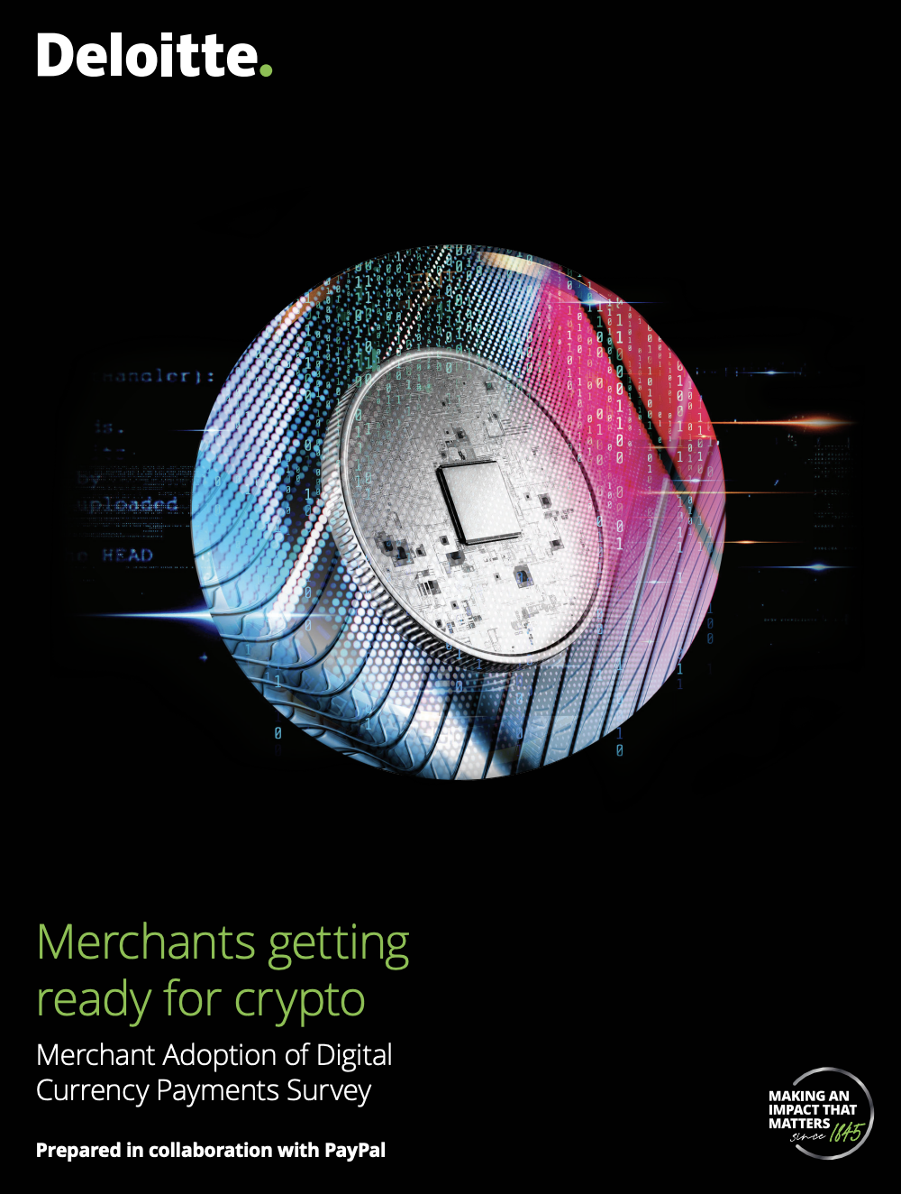
There are many advantages to this architecture over existing commercial solutions. Today, users largely have to choose between the traditional payment cards or blockchain transactions.
Today’s commercially available “crypto” payment cards give users no control over the assets on chain.
Meanwhile, blockchain native payments are not widely supported and requires specialized infrastructure.
There is very strong demand for crypto payments by both merchants and customers, leading to several crypto payment providers. These providers have no connection with traditional financial networks and must be manually integrated each time and require a user to have a smart wallet.
For readers curious as to how and why merchants are gearing up to accept crypto and how much they are investing in the space, we’d recommend reading this public report by Deloitte.
https://www2.deloitte.com/content/dam/Deloitte/us/Documents/technology/us-cons-merchant-getting-ready-for-crypto.pdf
US, EU laws, the terms and service of VISA and MasterCard, and several regulatory bodies have stated in no uncertain terms that payment card fraud is not the liability of the consumer and those transactions must be reversible. A large portion of ISO8583 messages are related to transaction reversals.
Notes:
https://www2.deloitte.com/content/dam/Deloitte/us/Documents/technology/us-cons-merchant-getting-ready-for-crypto.pdf

Slide 36



The proposed system allows users to utilize the full breadth of functionality of the blockchain as well as payment card infrastructure for everyday payments.
In comparison to today’s commercial crypto card products, users can take full advantage of DeFi while still using their accounts and payment cards for existing merchants.
Smart Wallet
These transactions are directly sent to the network
Users use their wallet to perform on-chain transactions, such as transfers to liquidity pools or directly to other users.
Though some transactions may potentially need authorization from the oracle to prevent issues with reversable funds.
Payment Card/Virtual Debit Card
Traditional Networks
PCIDSS Company/Oracle
Users can also swipe their payment card anywhere payment cards are accepted.
Which is routed through traditional networks as an ISO8583 message to the PCIDSS Company.
The Company verifies the funds exist on the network and there are no pending transactions and issues an authorization back to the merchant and the transaction to the network.

Slide 37



It also improves on crypto payment gateways by simplifying the user experience, automatically increasing merchant adoption, and allowing for increased protection for both merchants and users.
An oracle based architecture improves on many of the key weaknesses of modern competing crypto payment solutions such as Coinbase Commerce, Coingate, Bitpay and others.
User Experience
The user experience for payments is dramatically simplified and seem less risky, even for users with zero exposure to crypto, as users transact in the exact manner they are already familiar with. All of the major changes related to transaction routing are behind the scenes.
Merchant Adoption
Integrating with payment card networks means merchants no longer need to worry about setting up integrating new crypto payment gateways with their front end store or accounting software. Furthermore, the dispute process for fraud is familiar and routine.
Security
This architecture offers consumer protection in line with traditional payment methods. Furthermore, the oracle controlling company can authorize transaction in real-time allowing merchants to have more certainty around payments instead of competing solutions which require confirmation times of several minutes to hours.

Slide 38

In the future, blockchain based settlement might also allow for immediately settlement on a 1:1 basis instead of merchants and banks waiting for a weekly or, at best, nightly batch process.
Traditionally approved ISO8583 messages are batched and sent for settlement in a single aggregated transaction.
With a 24/7 blockchain, this settlement process would be 1:1 for transactions and immediate.
Payment Processer
Stripe
Acquiring Bank
Oracle Company
Payee Address
ACH Settlement
1-14 Days Batched Transactions
Instead of batching, this proposal initiates an on-chain transaction immediately for approved transactions allowing 1:1 immediate settlements.
All of the approved transactions that took place during the settlement period are aggregated into a single grand total, and which is either debited or credited to the bank account on file.
Merchant Account
Payment Address
The exact process varies by payment gateway, but settlement periods range from overnight to a week. The general processes is similar in that all the transactions are batched into a single grand total that is then settled at an aggregate level as a single lump sum.
On the ledger, transactions are relatively low cost compared to 1960s settlement technology which allows us to perform 1:1 immediate settlements instead of batching the transactions to reduce network demand. Though depending on network capacity, we can also batch transactions to reduce the fees, similar to a layer 2 solution.
Notes:
https://blog.unibulmerchantservices.com/authorization-clearing-and-settlement-how-mastercard-works/

Slide 39
In conclusion, we are advocating a centralized oracle based solution, as it seems to offer the best solutions to perform reversals, keep information secure, and recover in case of an authority breach.
Information Security
Data is securely accepted by and stored behind a centralized PCIDSS compliant corporation. This corporation initiates transactions through a public Oracle. This prevents any ISO8583 messages from ever being in advertently placed on the blockchain and allows us to comply with local state and country regulations.
Authority
The reason we use a centralized oracle over a simple master account in the smart contract is to establish authority with recoverable access control. If the worst case scenario happens and the centralized oracle’s domain is hacked, the domain owner can easily recover control of the account from the domain name provider.
Reversals
A specialized smart contracts extends the ERC20 standard to support reverse transactions based on the input of the centralized oracle. The smart contract also handles tracking and segregating reversable funds from a user’s liquid balances.

Slide 40
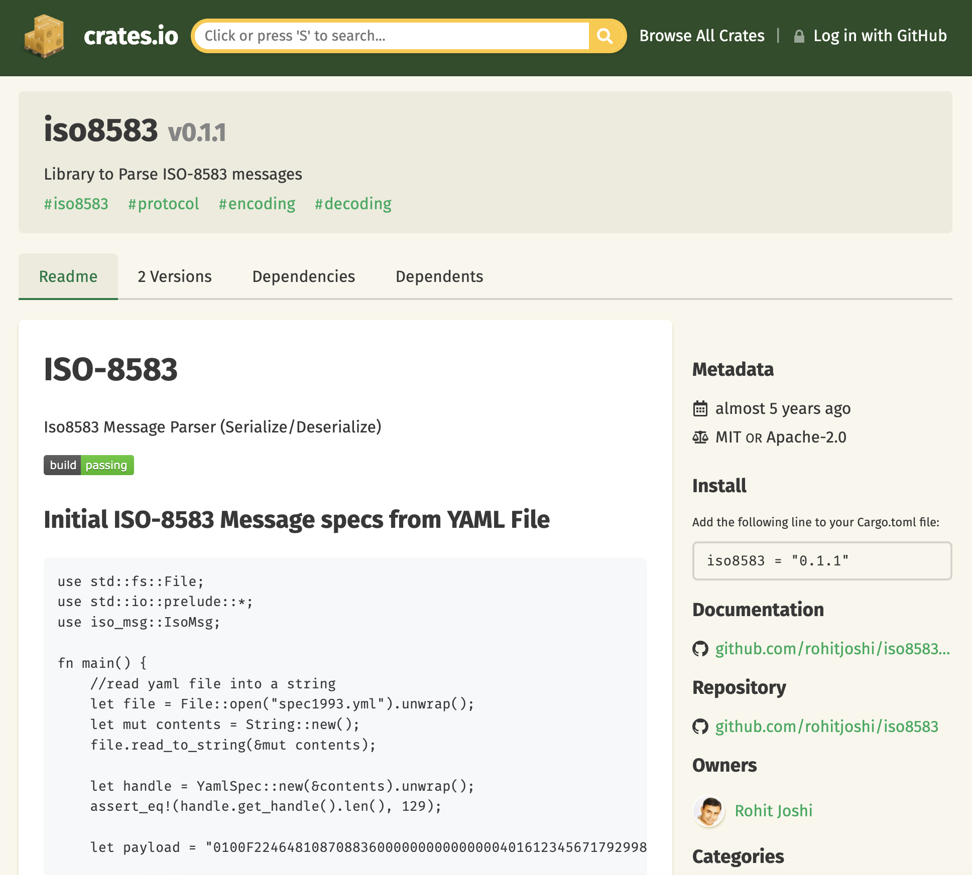
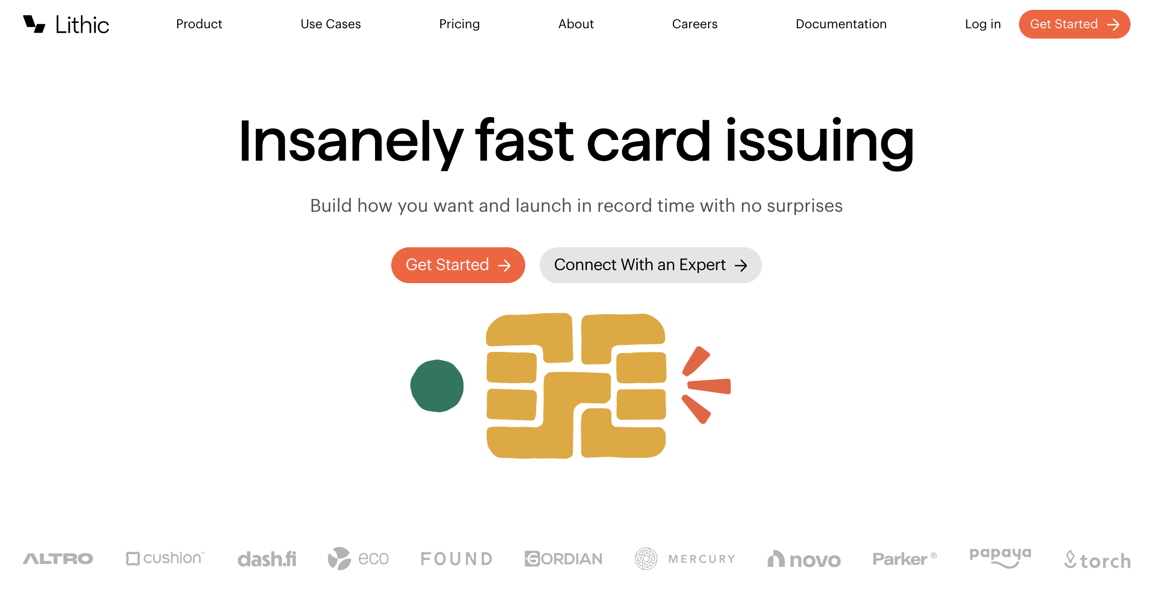
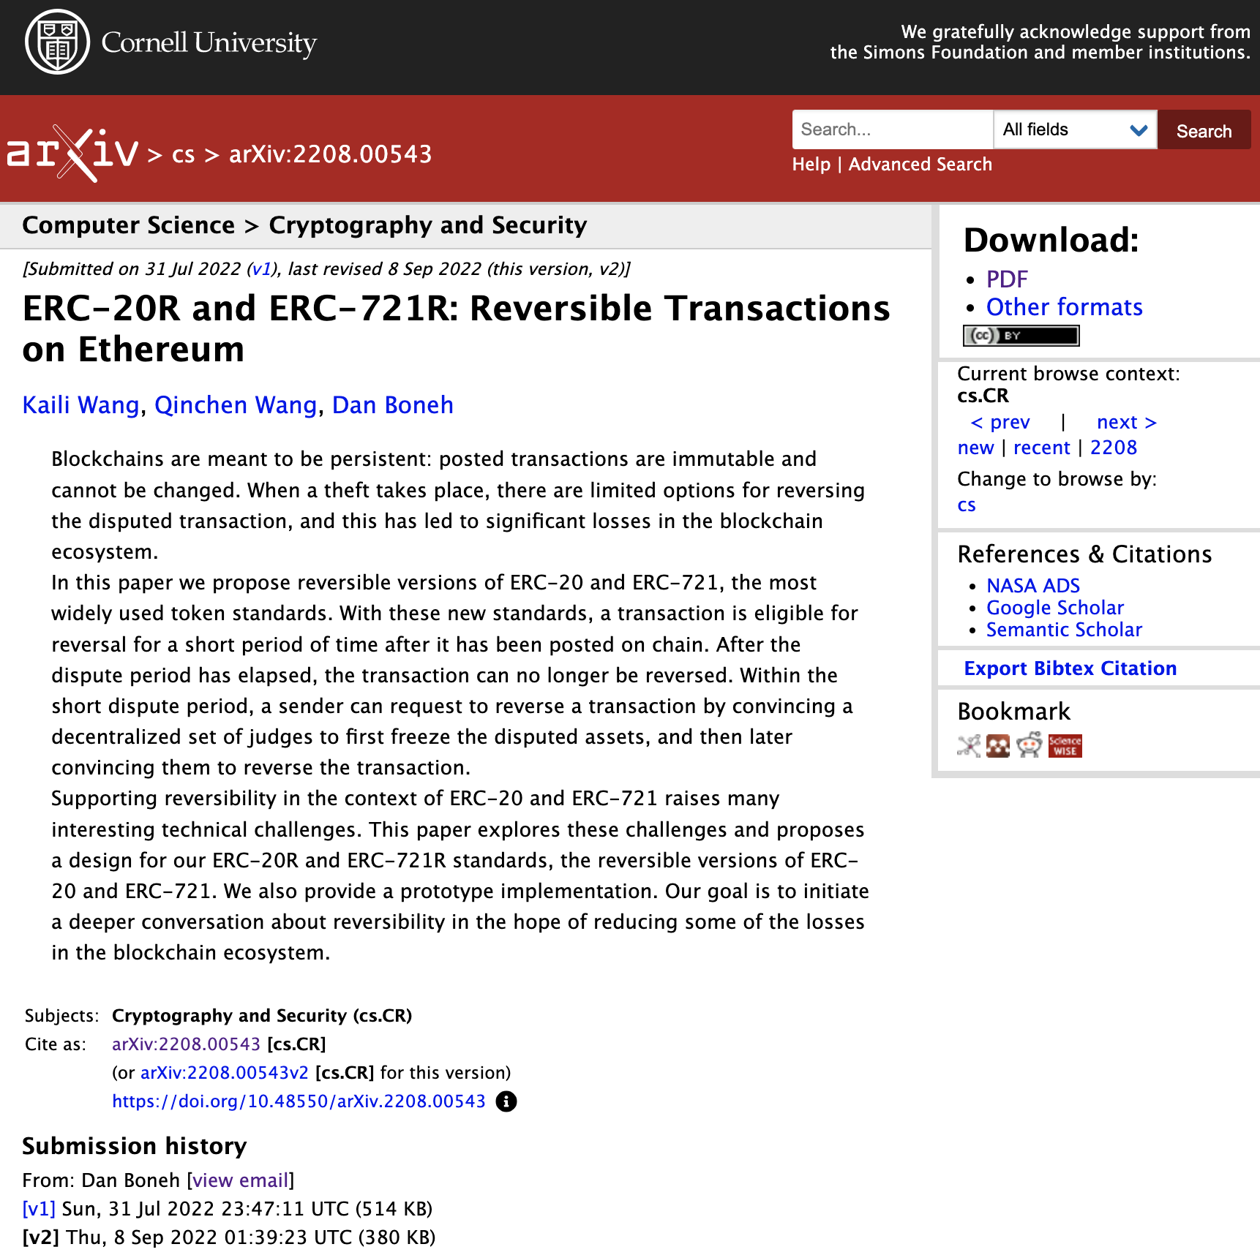
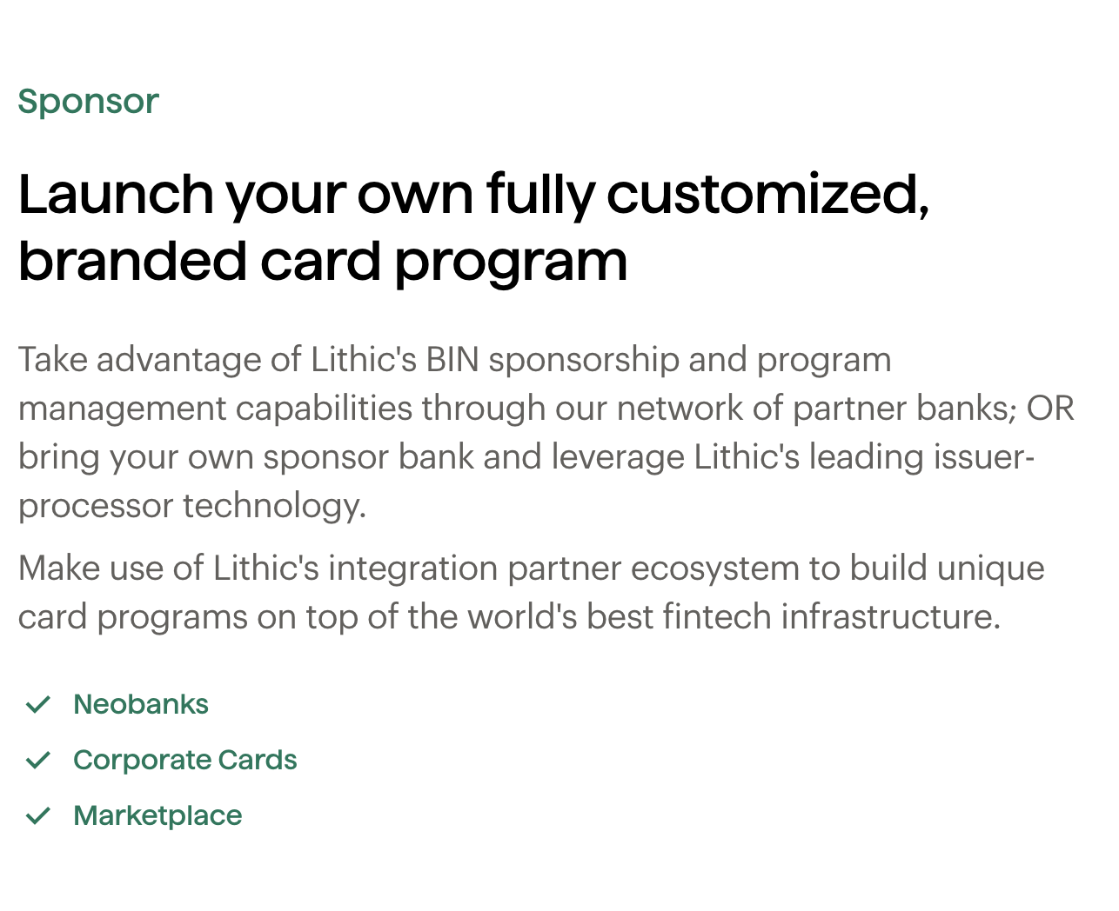
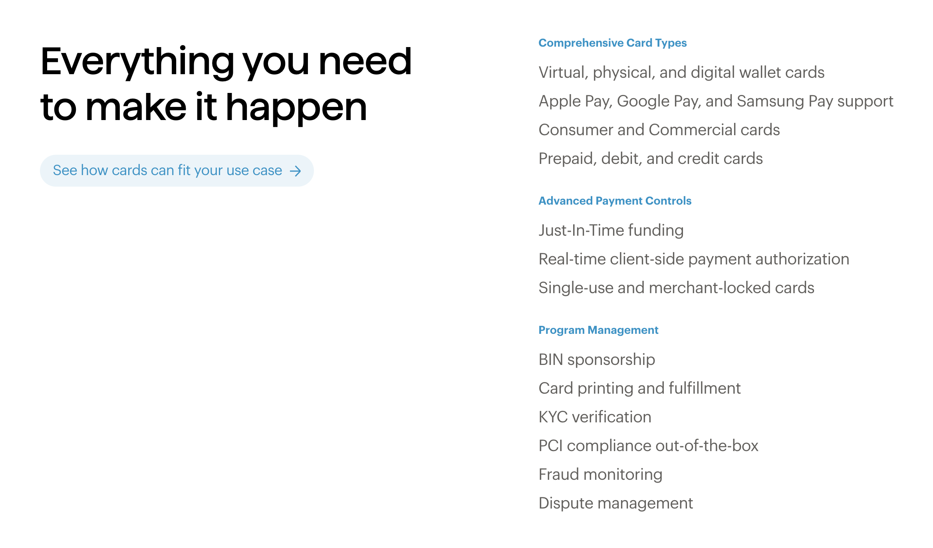
The technical build is straightforward compared to the financial infrastructure. However, the complexity can be reduced by leveraging open source libraries and partners.
The technical implantation is relatively straightforward and can leverage several open source libraries.
Setting up the financial infrastructure is the more difficult challenge, but has been simplified thanks to modern tools.
While at first glance it might seem intimidating to set up financial infrastructure, the very recently launched banking-as-a-service infrastructure companies can dramatically simplify the process. Lithic, for example, provides payment card issuance services primarily for “neobanks”, however these tools are the exact ones we require and can easily be repurposed for our purposes, dramatically reducing the build out required to reach MVP.
The next steps would be to build a prototype of the oracle and smart contract and deploy them to a substrate based testnet. The smart contract would adopt the open source ERC20R standard as a start, while the oracle can leverage open source ISO8583 Rust crates to speed development.
Notes:
https://arxiv.org/abs/2208.00543
https://crates.io/crates/iso8583
https://lithic.com/

Slide 41
The recommended next step would be to prove the technical feasibility by constructing an oracle that can accept ISO8583 messages and push them to a smart contract on a testnet.
We recommend tackling the technical implantation first, then using banking-as-a service firms to issue a very small number of physical plastics that integrate directly with the oracle and testnet as a very limited initial test.
1
2
3
Technical Build: Oracle
Develop an opensource API platform that can that can accept randomly generated, fake ISO8583 transactions and authorize them through an oracle for execution on-chain.
Technical Build: Smart Contract
Implement either a version of the ERC20R or an improved contract that has the ability to perform authorized transactions as well as reverse them, on demand, in accordance with the oracle.
Technical Build: Deploy and Test
These tools should be deployed to a testnet, and then opened to allow users and the internal team to test with artificially generated, fake ISO8583 messages routed to the API endpoint.
6
5
4
Infrastructure: 2nd Alpha Test
Move towards another test in partnership with a payment network. The aim is to deliver cards issued by the holding company’s BIN number that reflect a real balance of custodied stablecoins and that are cleared through the payment networks’ settlement layer overnight (e.g. VisaNet).
Infrastructure: Leverage Fast Track Programs
Leverage programs like VISA’s Fintech Fast Track to quickly develop the ability to issue cards with greater control. While BaaS will work well for a very limited card test, it is unlikely to suffice for commercial blockchain applications.
Infrastructure: Issue the First Few Test Plastics
The next test would be to build and test infrastructure connections to that API endpoint. The fastest way, would be to partner with a banking-as-a-service provider that issue debit cards and route messages while serving as a BIN sponsor.
Notes:
https://partner.visa.com/site/programs/fintech-program.html

